Slide 1

Meaning and definitions of Operations Management
Objectives of OM
The transformation process
Differences between production and service operations
Operations and supporting functions;
Role of the operations manager;
Scope of operations management;
Production system: Intermittent and continuous;
Key issues for operations managers;
Historical evolution of operations management;
Productivity: concepts,
Types of Productivity
Factors affecting productivity;
Productivity measurement,
Concept on green productivity;
Supply chain management ( concept only).

Slide 2
Operations management is a set of activities on the basis of which inputs are converted into the outputs as desired by the customers.
Operations management is also known as a process that helps in turning input resources into outputs.
Operations management is a value adding activity through
the conversion process/transformation process.
Operations management is also a value creating activity
rights
through understanding, matching or managing four
(i.e., right products or services, right time or timing, right approaches or methods and right customers)

Slide 3
1.
Figure 1.1 A Simple Production/Operations System
Random Fluctuations [Unplanned or unexpected events as
strikes, machinery breakdown]
Quality of Inputs Adjustments
Quality of Outputs Monitoring and Evaluation
Inputs
[M⁵ × I × L]
Transformation Process
[M³ × S]
Outputs [G or S]
Manpower
Machinery
Money or capital
Materials
Management
Information
Land & building
Goods or
Service
Manpower
Machinery
Management
Scheduling
Feedback [Comparison between standard
and actual outcomes]

Slide 4

Mainly, operations management has its three basic elements (i.e., Inputs, Process and Outputs).
Inputs are the basic resources that are useful for effective processing and quality production of goods and services.
Inputs may include materials, manpower, machinery, money/capital, management/methods, information and land and building (also popularly known as 5M×I×L).
Processing is known as heart (major) to the operations activity essential for converting inputs into outputs.
Process may includes manpower, machinery/technology, management and scheduling (also known as 3M× S).
Outputs are the end results from quality inputs and processing as either goods or services or both.

Slide 5
Some definitions of Operations Management are mentioned below:
According to Lee J. Kraiewski, Larry P. Ritzman, "The term Operations Management refers to the direction and control of the processes that transform inputs into products and services."
According to Richard B. Chase, Nicholas J. Aquilano & F. Robert Jacobs, "Operations Management may be defined as the design, operation and improvement operations of the production systems that create the firm's primary products or services."
According to Everett E. Adam Jr., Ronald J. Ebert, "The operations manager's job is to manage the process of converting inputs into desired outputs."
According to Jay Heizer and Barry Render, "Operations management is the set of activities that creates value in the form of goods and services by transforming inputs into outputs.”
From the above definitions, operations are purposeful actions or activities which are methodically as part of a plan of work by a process that is designed to achieve the pre-decided objectives. It indicates that operations management consists of tactics such as scheduling work, assigning resources including people, equipment, managing inventories, assessing quality standards, process type decisions and the sequence for making individual items is a product mix set to put it simply. Operations management is understood as the process whereby resources or inputs are converted into more useful products.

Slide 6
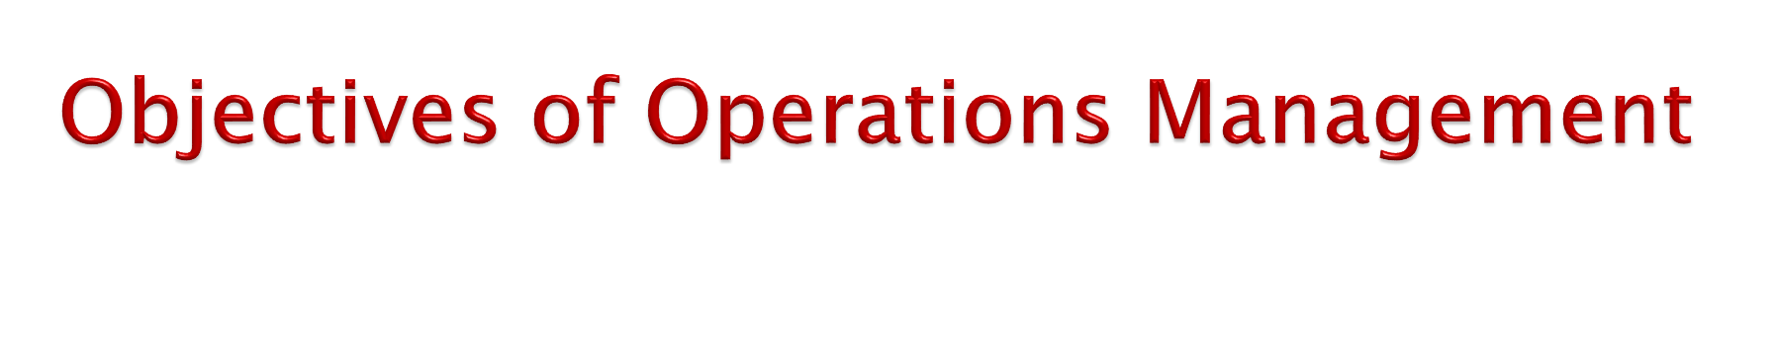
Operations management enables the systematic design, direction and control of processes that transform inputs into services and product for internal, as well as external, customers. Thus, the objectives of operations management are as follows:
To produce quality goods and services as per the customer’s demands and
expectations.
To fulfillment of the interests of stakeholders (i.e., customers, suppliers, employees, shareholders or investors, local community, government etc.).
To make optimum utilization of various inputs like manpower, machine, materials, money.
To minimize costs and losses.
To improve profits and values.
To improve operation of production system in order to create value.
To increase efficiency in production capacity by reducing the labour turnover rate.
To adapt the changing environment.
To introduce friendly environment products with minimum wastage and scrap.
To improve labour relation and energize the workers for higher production.
To increase organizational goodwill and employees’ morale.
To help managers develop the necessary skills in order to achieve numerous and lucrative career opportunities.

Slide 7
Every manufacturing or service organization transforms certain inputs into outputs.
For getting the desired output, the quality of the inputs has to be monitored. The quality of the actual output obtained also has to be continually compared with the desired outputs.
As shown in figure below, feedback mechanisms are required to monitor the performance of transformation or conversion process.
In other words, the main part of production and operations management system is transformation process.
It transforms certain available inputs or resources into the desired outputs with the help of manpower, machinery, management and scheduling (M³ × S).
There may be some random disturbances hampering the transformation or conversion process of converting the inputs into desired outputs.
These random disturbances are unexpected and sometimes not
planned for.

Slide 8
1. The Transformation/Conversion Process
Random Fluctuation
Adjustments
Monitoring
Conversion Process
Inputs
Outputs
Feedback
There are different factors or the elements which have great role in transforming inputs into the desired outputs.
Transformation process is the part of the system that adds value to the inputs.
Value can be added to an entity in a number of ways.
In the transformation process, mainly manpower, machinery or technology, management, schedule etc. play important role in converting inputs into desired outputs.
An example of transformation process is shown in figure below:

Slide 9
The Transactions Process for a Purely Manufacturing Organization (A Refrigerators Manufacturer)
1.
Quality of Inputs inspection and adjustment
Quality of Outputs Monitoring and Evaluation
Inputs
Outputs
Machines & Equipment
Components
Parts, Sub-assemblies, etc
Office Infrastructure (Computer, Furniture, etc)
Packing materials
Capital
Land & building
Workers
Managers
Transformation process
Good cooling performance of refrigerators
Consumption of electricity
New Advance features
Random Disturbance
High turnover of workers & managers
Recession
Govt. taxation policies
Strikes by trade union and others
Feedback
Rising sales volume
Lesser customer complains
Positive responses of customers.

Slide 10
It is important to note that goods and services often occur jointly. For example, having the oil changed in your car is a service, but the oil that is delivered is a good. Similarly, house painting is a service, but the paint is a good.
It can range from primarily goods, with little service, to primarily service, with few goods.
The essence of the operations function is to add value during the transformation
process.
Value-added is the term used to describe the difference between the cost of inputs and the value or prices of outputs.
In non-profit organizations, the value of outputs (e.g., highway construction, police and fire protection) is their value to society; the greater the value-added, the greater the effectiveness of these operations.
In the profit organizations, the value of output is measured by the prices that customers are willing to pay for these goods or services.
There are many factors that affect the design and management of operations systems.
Among them are the degree of involvement if customers in the process and the degree to which technology issued to produce and/or deliver a product or service.
The greater the degree of customer involvement, the more challenging it can be to
design and manage the operation.
Technology choices can have a major impact on productivity, costs, flexibility, and quality and customer satisfaction.
Outputs can be classified as: need based, expectation based and new creation based.

Slide 11
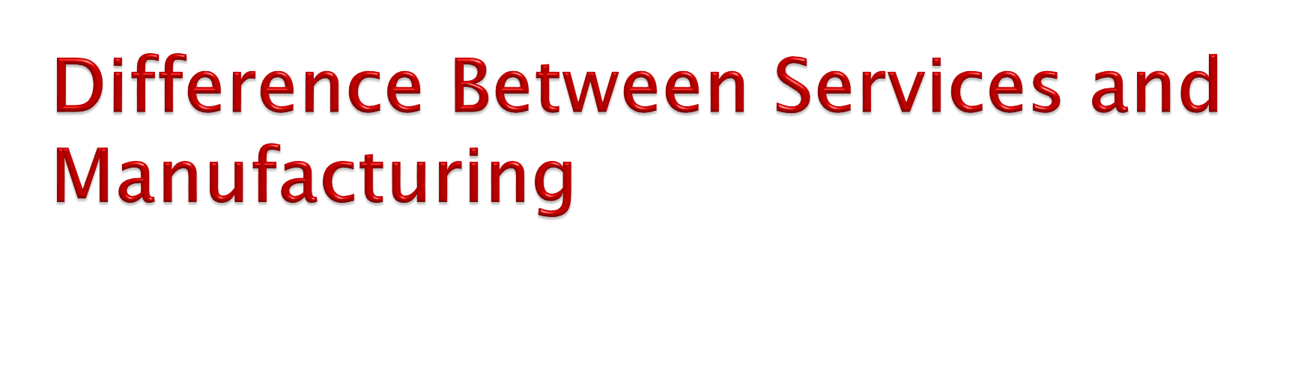
Characteristics | Manufacturing /Goods | Services
Customer contact | Low | High
Uniformity of inputs | High | Low
Labour Content | Low | High
Uniformity of outputs | High | Low
Outputs | Tangible | Intangible
Measurement of Productivity | Easy | Difficult
Opportunity to correct quality problems before delivery to customer | High | Low
Inventory | Much | Little
Evaluation | Easier | More difficult
Patentable | Usually | Not usually

Slide 12
1.
Difference between Production and Service Operations
Basis | Production/Manufacturing Operations | Service Operations
Nature of Output | It yield tangible output from conversion | Service operations produce intangible output.
Consumption of Output | Output of the manufacturing operations can be consumed over time. | Services output are consumed immediately.
Nature of work | Manufacturing operations are capital intensive because they use less labour and more machines and equipments. | Service operations are labour intensive. They use more labour and less machine and equipments.
Degree of customer’s contact | Frequent customers’ contact is not required in manufacturing operations. | Without customer contact, no service can be generated.
Customers’ Participation | Once order is received, there is no need of customers’ participation in conversion process. | In service operations, service generation is impossible without participating customers in the process.
Measurement of Performance | Sophisticated methods are used to measure manufacturing operations. | Simple methods are used to measure service operations.
Market | They produce goods for local, regional, and international. | They generally provide services for local people.
Process | Complex and interrelated processes are followed in manufacturing operations. | Simple service process is applied in service operations.

Slide 13
1. Planning Functions
Development of Systems and Others (rules, regulations, policies and
strategies to the operations department).
Product/Service Planning (product design, looks, features, costs, prices, quality etc.).
Location Planning (materials, manpower, market/customers, geographical structure, climate, cost of land, socio-cultural issues, infrastructure-transportation, communication, health, education, water supply, banking and insurance etc.).
Layout Planning (internal settings and the fittings with the constructions of different buildings and others such as machinery set-up, store rooms, warehouses, rest rooms, office room, public or customer contact room, canteen, parking etc.).
Process Planning (processes understanding, development, evaluation, selection, implementation etc.).
HR Planning (understanding the requirement of manpower, recruitment, selection, socialization, training and development, compensation management, performance evaluation, dispute and conflict handling etc.).
Forecasting (qualitative and quantitative techniques including short-term, mid- term and long-term).

Slide 14
2. Organizing Functions
Organizational hierarchy development for the operations department.
Communication pattern or system development for the department.
Selection and use of management and leadership styles.
Job analysis structuring (job descriptions and job specifications).
Job evaluation and measurement criteria development.
Projects development with contracting and outsourcing provisions etc.
Controlling Functions
Costs and prices
Quality
Materials
manpower
Machinery and technology
System, process and procedures etc.

Slide 15
4. Behaviour Functions
As an operations manager, we have to control the behaviour of the employees using following three management functions practically:
Effective Communication
Effective Motivation
Effective Leadership.
Modeling Functions
Modeling are the approaches or methods that are used to simplify the complexities at the workplace. As an operations manager, following operations models are to be understood and used as per requirement:
Linear Programing models
Queuing Models
Inventory models
Control charts models
Networking models
Simulation models etc.

Slide 16
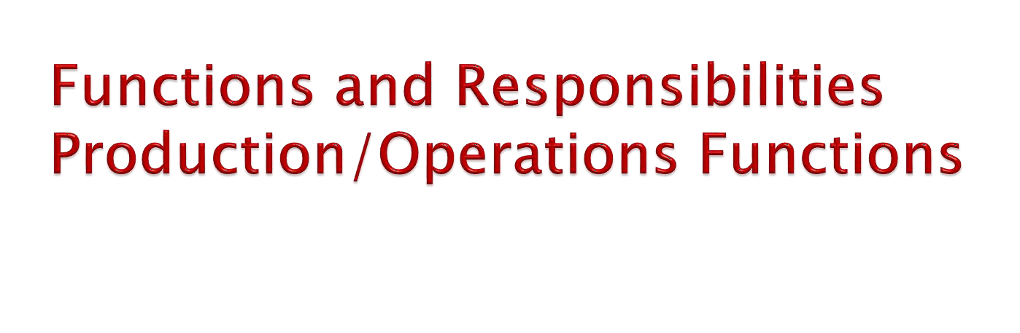
The following are the duties and responsibilities of production managers in manufacturing and service organizations:
Purchasing production equipment and materials.
Designing production process.
Planning the geographical location of the factory or service center.
Layout of settings within the factory service center.
Designing production work and establishing work standards.
Product/Service design.
Capacity planning.
Production planning and scheduling.
Supply chain management.
Production and quality control.
Inventory management.
Measurement and monitoring of productivity.
Production equipment maintenance and repair.
Industrial relations.
Staff selection and budgeting etc.

Slide 17

Scope of Operations Management
Location of Facilities
Plant Layouts and Material Handling
Product Design
Process Design
Production and Planning Control
Quality Control
Materials Management
Maintenance Management.

Slide 18
Location of Facilities
Location of facilities for operations is a long-term capacity decision which involves a long term commitment about the geographically static factors that affect a business organization. It is an important strategic level decision-making for an organization. It deals with the questions such as ‘where our main operations should be based?’
The selection of location is a key-decision as large investment is made in building plant and machinery. An improper location of plant may lead to waste of all the investments made in plant and machinery equipments. Hence, location of plant should be based on the company’s expansion plan and policy, diversification plan for the products, changing sources of raw materials and many other factors. The purpose of the location study is to find the optimal location that will results in the greatest advantage to the organization.
Plant Layout and Material Handling
Plant layout refers to the physical arrangement of facilities. It is the configuration of departments, work centers and equipment in the conversion process. The overall objective of the plant layout is to design a physical arrangement that meets the required output quality and quantity most economically.
‘Material Handling’ refers to the ‘moving of materials from the store room to the machine and from one machine to the next during the process of manufacture’. It is also defined as the ‘art and science of moving, packing and storing of products in any form’. It is a specialized activity for a modern manufacturing concern, with 50 to 75% of the cost of production. This cost can be reduced by proper section, operation and maintenance of material handling devices. Material handling devices increases the output, improves quality, speeds up the deliveries and decreases the cost of production. Hence, material handling is a prime consideration in the designing new plant and several existing plants.

Slide 19
Product Design
Product design deals with conversion of ideas into reality. Every business organization have to design, develop and introduce new products as a survival and growth strategy. Developing the new products and launching them in the market is the biggest challenge faced by the organizations. The entire process of need identification to physical manufactures of product involves three functions: marketing, product development, manufacturing. Product development translates the needs of customers given by marketing into technical specifications and designing the various features into the product to these specifications. Manufacturing has the responsibility of selecting the processes by which the product can be manufactured. Product design and development provides link between marketing, customer needs and expectations and the activities required to manufacture the product.
Process Design
Process design is a macroscopic decision-making of an overall process route for converting the raw material into finished goods. These decisions encompass the selection of a process, choice of technology, process flow analysis and layout of the facilities. Hence, the important decisions in process design are to analyze the workflow for converting raw material into finished product and to select the workstation for each included in the workflow.

Slide 20
Production Planning and Control
Production planning and control can be defined as the process of planning the production in advance, setting the exact route of each item, fixing the starting and finishing dates for each item, to give production orders to shops and to follow up the progress of products according to orders.
The principle of production planning and control lies in the statement ‘First Plan Your Work and then Work on Your Plan’. Main functions of production planning and control includes planning, routing, scheduling, dispatching and follow-up.
Quality Control
Quality Control (QC) may be defined as ‘a system that is used to maintain a desired level of quality in a product or service’. It is a systematic control of various factors that affect the quality of the product. Quality control aims at prevention of defects at the source, relies on effective feedback system and corrective action procedure.
Quality control can also be defined as ‘that industrial management technique by means of which product of uniform acceptable quality is manufactured’. It is the entire collection of activities which ensures that the operation will produce the optimum quality products at minimum cost.
Maintenance Management
Maintenance management involves keeping track of assets and parts. The purpose is to ensure that production proceeds efficiently and the minimum amount of resources are wasted. This is generally accomplished by a tailored combination of software, practices, and personnel that focus on achieving these goals.

Slide 21
The production system according to nature and the volume of production (quantity of output) can be broadly classified into following two categories:
Intermittent Production System
Intermittent production is justified when the production rate exceeds demand rate. The quantities in intermittent production are decided based on the balancing of two costs i.e. setup cost and inventory carrying cost. Batch production aims at satisfying the continuous customer demand for an item. However, the plant is capable of production rate that exceeds demand rate. Batch production plants include machine shops, furniture manufacturing company, hospitals, plastic units and press shops.
Characteristics of Intermittent Production System
Production quantity is small.
More number of set ups and hence higher set up cost.
Plant and machinery set up is used for the production of items in a batch and set up required to be changed for processing next batch of items.
Amount of supervision required is less compared to job order.
Plant and machinery are highly flexible.
Manufacturing lead time and also cost are lower.
Higher level of work in process inventory.

Slide 22
Advantages of Intermittent Production System
Better utilization of plant and machinery.
Cost per unit is lower as compared to job order production.
Promotes functional specialization.
Lower investment in plant and machinery.
Flexibility to accommodate and process number of products.
Job satisfaction exists for operators.
Disadvantage of Intermittent Production System
Material handing is complex because of irregular and longer flows.
Production planning and control is complex.
Work in process inventory is higher compared to continuous production.
Longer production time.
Higher set up costs due to frequent changes in set up.
Lower utilization of production facilities compared to mass
production.

Slide 23
Continuous Production System
Continuous production system manufacture highly standardized non-discrete products in extremely large volumes using a continuous process. Products that flow into continuous streams fall in this category. Continuous production system develop extensive long range resource requirement and they are more capital intensive. Plant location, plan capacity, long range plan for materials, manpower, energy and waste disposal are the important aspects in continuous production system. Continuous process scheduling will be capacity controlled and no other shop floor control is required.
The output (product) from continuous production have few design low unit values and relatively high transportation costs, cost per unit minimized by using high volume, dedicated equipment arranged in production lines, minimizes cost per unit. In continuous production system the production process generally follows a specific and fixed sequence of operations. Petroleum products, steel, sugar, flour, paper, cement, fertilizers, etc. are some of the examples of products produced continuous production system.

Slide 24
Characteristics of Continuous Production System
Dedicated plant and equipments with zero flexibility.
Material handling is fully automated.
Wet or dry product flow measurable by weight or volume.
Component materials cannot be readily identified with final product and the product cannot be disassembled.
Larger investment and usually capital intensive units.
Process follows a pre-determined sequence of operations.
Maintenance is an important aspect.
Unit cost is lower due to high volume
Planning and scheduling is a routine action.
Persons with (semiskilled) limited skills can be used
on the production line.

Slide 25

Designing the System
Designing the system begins with product development. Product development involves determining the characteristics and features of the product or service to be sold. It should begin with an assessment of customer needs and eventually grow into a detailed product design. The facilities and equipment used in production, as well as the information systems needed to monitor and control performance, are all a part of this system design process.
a. Product Design: It is a critical task because it helps to determine the characteristics and features of the product, as well as how the product functions. Product design determines a product's cost and quality, as well as its features and performance.
b. Process Design: It describes how the product will be made. The process design decision has two major components: a technical (or engineering) component and a scale economy (or business) component. The technical component includes selecting equipment and selecting a sequence for various phases of operational production.
c. Facility Design: It involves determining the capacity, location, and layout for the production facility. Capacity is a measure of a company's ability to provide the demanded product in the quantity requested by the customer in a timely manner. Capacity planning involves estimating demand, determining the capacity of facilities, and deciding how to change the organization's capacity to respond to demand.
Facility location is the placement of a facility with respect to its customers and suppliers. Facility location is a strategic decision because it is a long-term commitment of resources that cannot easily or inexpensively be changed.
Facility layout is the arrangement of the workspace within a facility. It considers which departments or work areas should be adjacent to one another so that the flow of product, information, and people can move quickly and efficiently through the production system.

Slide 26
Implementation
Once a product is developed and the manufacturing system is designed, it must be implemented, a task often more easily discussed than carried out. IF the system design function was done thoroughly, it will have rendered an implementation plan which will guide activities during implementation. Nonetheless, there will inevitably be changes needed. Decisions will have to be made throughout this implementation period about tradeoffs.
Planning and Forecasting
Running an efficient production system requires a great deal of planning. Long-range decisions could include the number of facilities required to meet customer needs or studying how technological change might affect the methods used to produce services and goods. The time horizon for long-term planning varies with the industry and is dependent on both complexity and size of proposed changes. Typically, however, long-term planning may involve determining work force size, developing training programs, working with suppliers to improve product quality and improve delivery systems, and determining the amount of material to order on an aggregate basis.
Managing the System
Managing the system involves working with people to encourage participation and improve organizational performance. Participative management and teamwork are an essential part of successful operations, as are leadership, training, and culture. In addition, material management and quality are two key areas of concern.
Material management includes decisions regarding the procurement, control, handling, storage, and distribution of materials. Material management is becoming more important because, in many organizations, the costs of purchased materials comprise more than 50 percent of the total production cost. Questions regarding quantities and timing of material orders need to be addressed here as well when companies weigh the qualities of various suppliers.
Building Success with Operations
To understand operations and how they contribute to the success of an organization, it is important to understand the strategic nature of operations, the value-added nature of operations, the impact technology can have on performance, and the globally competitive marketplace.
Efficient organization operations are a vital tool in achieving competitive advantage in the daily contest for customers/clients. What factors influence buying decisions for these entities? For most services and goods, price, quality, product performance and features, product variety, and availability of the product are critical. All these factors are substantially influenced by actions taken in operations.

Slide 27
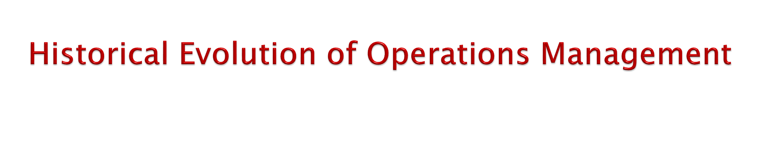
The history of operations management (POM) is very rich and interesting.
It did not begin until the industrial revolution in the 1700s.
At the time, there exists craft production: a process of handcrafting products or services for individual customers.
The development of operations management has its three phases: manufacturing management phase, production management phase and operations management phase.
At the time of the manufacturing management phase (before 1930s), labours were mostly used to manufacture goods to the customers without providing sufficient facilities to them. No proper system of manufacturing was used at that time.
At the time of production management phase (between 1930s to 1970s), machineries or technologies was emphasized more rather than used of labours. Mass production and economize of scale are the main focus at that phase.
At operations management phase (since 1970s..), quality processing rather than mass production, mass customization, use of internet, environmentally friendly production, e-business environment, JIT production etc. are emphasized.
The heritage of operations management can be better understood with the help of following table:

Slide 28
1. Historical Events in Operations Management
Era | Events/Concepts | Dates | Originator
Industrial Revolution | Steam engine Division of labour Interchangeable parts | 1769 1776 1790 | James Watt Adam Smith Eli Whitney
Scientific Management | Principles of Scientific Management Time and motion studies Activity Scheduling Chart Moving assembly line | 1911 1911 1912 1913 | F.W. Taylor Frank & Lillian Gilbreth Henry Gantt Henry Ford
Human Relations | Hawthorne studies Motivation theories | 1930 1940s 1950s 1960s | Elton Mayo Abraham Maslow Frederick Herzberg Douglas McGregor
Operations Research | Linear Programming Digital computer Simulation, Waiting line theory, decision theory, PERT/CPM MRP, EDI, EFT, CIM | 1947 1951 1950s 1970s | George Dantzig Remington Rand Operations Research Groups Joseph Orlicky, IBM
Quality Revolution | JIT (Just-in-time) TQM (Total quality management) Strategy and operations Business process reengineering Six Sigma | 1970s 1980s 1980s 1990s 1990s | Taiichi Ohno (Toyota) W.Edward Deming, Joseph Juran Wickham Skinner, Robert Hayes Michael Hammer, James Champy GE, Motorola
Internet Revolution | Internet, WWW, ERP, Supply Chain Management E-Commerce | 1990s 2000s | ARPANET, Tim Berners-Lee SAP, i2 Technologies, ORACLE Amazon, Yahoo, eBay, Google and others
Globalization | World Trade Organization, European Union and other trade agreements | 1990s | Numerous countries and companies
 | Global supply chains, outsourcing, BPO, Services, Science | 2000s
Source: Russell & Taylor, (2009). “Operations Management”

Slide 29
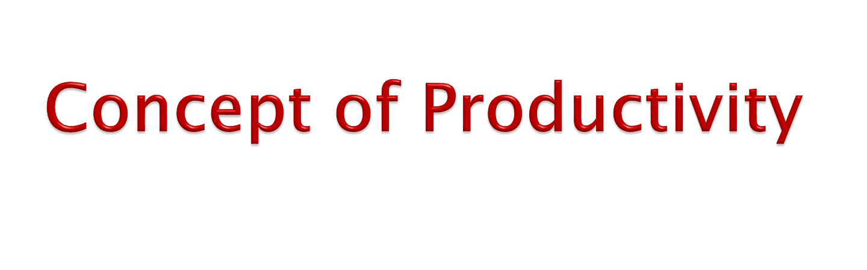
Productivity is the quantitative relationship between what we produce and what we use as a resource to produce them i.e., arithmetic ratio of amount produced (outputs) to the amount of resources (inputs). The productivity can be expressed as:
Productivity =^{𝑻𝒐𝒕𝒂𝒍 𝑶𝒖𝒕𝒑𝒖𝒕𝒔} > 1
𝑻𝒐𝒕𝒂𝒍 𝑰𝒏𝒑𝒖𝒕𝒔
The ratio of productivity must be greater than 1 from operations perspective to define it. It is the multiplier effect of efficiency and effectiveness of an operations manager’s work. Therefore, it can be also defined as:
Productivity = Work Efficiency + Work Effectiveness
The productivity refers to the efficiency of the production system. Thus, the productivity is defined as the efficient use of resources such as: capital, labour, land, materials, energy, information etc. in the production of various goods and services.

Slide 30
Productivity can be increased with the help of following actions:
When production is increased without increase in inputs (+outputs, Inputs).
2.
The same production with decrease in inputs (Outputs, -
Inputs).
3.
The rate of increase in output is more compared to rate of
increase in input (+Outputs > + Inputs).
The concept of production and productivity are totally different. Production refers to absolute output whereas productivity is a relative term where output is always expressed in terms of inputs. Increase in production may or may not be an indicator of increase in productivity.
Increasing or improving productivity is not a easy task today. Up-to-date production system, modern technology, competent manpower, friendly and safe working condition, supplier partnering, teamwork, effective measurement of productivity, encouraging management or leaders etc. are very important aspects of increasing productivity today.

Slide 31
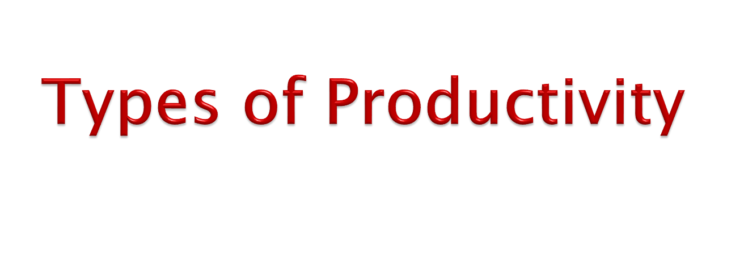
There are three basic types of productivity. They are as follows:
1. Partial Productivity
Partial productivity is the ratio of output to partial input. It helps to measure the productivity of each input such as labour, capital, energy, material and machine. Partial productivity determines the contribution of each factor in producing and generating output. It can be measured as follows:
Productivity =^{𝑻𝒐𝒕𝒂𝒍 𝑶𝒖𝒕𝒑𝒖𝒕𝒔} > 1
𝑺𝒊𝒏𝒈𝒍𝒆 𝑰𝒏𝒑𝒖𝒕
2. Factor Productivity
Factor productivity measures total output on the one hand and labour, capital, machine and material on the other hand. It can be measured as:
Productivity = ^{𝑻𝒐𝒕𝒂𝒍 𝑶𝒖𝒕𝒑𝒖𝒕𝒔} > 1
𝑪𝒂𝒑𝒊𝒕𝒂𝒍+𝑳𝒂𝒃𝒐𝒖𝒓
3. Total Productivity
Total productivity is the ratio of total output to the sum of all inputs. Thus, total productivity measures reflect the joint impact of all the inputs in producing and generating of output. It can be measured as:
Productivity =^{𝑻𝒐𝒕𝒂𝒍 𝑶𝒖𝒕𝒑𝒖𝒕𝒔} > 1
𝑻𝒐𝒕𝒂𝒍 𝑰𝒏𝒑𝒖𝒕𝒔

Slide 32
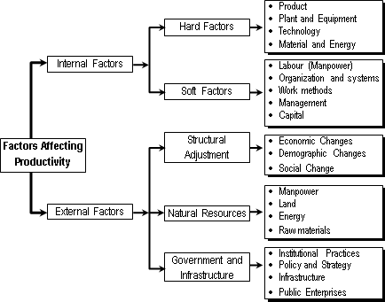

Slide 33
The factors affecting productivity can be classified into various groups. The following are
two main factors that affect productivity.
Internal Factors
Internal factors refer to those factors which are in the control of management or individual enterprises. All internal factors are not under the control but somehow they can be adjusted and managed with some ease in comparison to the external factors. These internal factors play a vital role in improving productivity level of an organization. Internal factors are also known as micro-productivity factors. These factors can be divided into two following groups.
Hard Factors: Hard factors are those internal factors which are quite inflexible towards organizational change in comparison to soft factors. These hard factors are as follows: Product, Plant/Equipment, Technology, Material and Energy etc.
Soft Factors: Soft factors are those factors which are quite flexible towards organizational changes, compared to hard factors. These factors can be changed according to the requirement of organizational management. Some of the soft factors are as follows: Labour, Organization and Systems, Work Methods, Management, Capital etc.
External Factors
External factors refer to those factors which are not in the control of management or any individual enterprises. The external factors directly/indirectly affect the productivity of an organization but also an organization has no control over them. These external factors are also called macro-productivity factors. They can be listed as follows:
a. Structural Adjustment
b. Natural Resources,
C. Government and Infrastructure

Slide 34
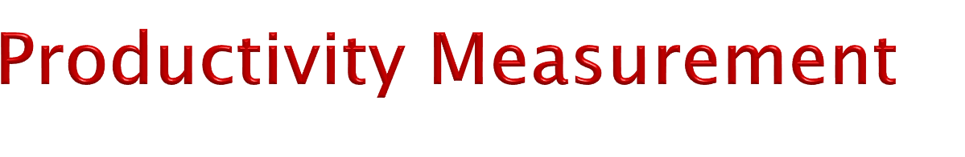
The measurement of productivity can be quite direct. Such is the case when productivity is measured by labour-hours per ton of a specific type of steel.
Although labour-hours are a common measure of input, other measures such as capital, materials, or energy can be used.
Measuring productivity can be a challenge so that a manager picks several reasonable measures.
For example, a manager at an insurance firm might measure office productivity as the number of insurance policies processed per employees per week.
In the case of services, it can be difficult to measure inputs and outputs as discrete units. As a result, productivity measured in services is usually geared more towards the availability and utilization of resources.
For example, the number of visits to the weight room per day can be used as an indicator of the value generated by that facility.
In the similar way, a manager at a carpet company might measure the productivity of installers as the number of square yards of carpet installed per hour.
Following are the some measurements of productivity made at various levels.

Slide 35
1. Productivity at International Level
Country A’s Productivity = ^{Total Output of Country A}
Total Input of Country A
Country B’s Productivity = ^{Total Output of Country B}
Total Input of Country B
Productivity at National Level
_{National Productivity =} Real Gross Domestic Product (GDP) at Factor Cost
Active Population
Where,
GDP = Total goods and services produced by the nation Active population = Total population − Non-active population
Productivity at Industrial Level
_{Industrial Productivity =} Real Value Added Contribution by Industry Group
Economically Active Population of Industry Group
Productivity at Company/Firm Level
Partial Productivity
Partial Productivity = ^{Total Output}
Partial Input
b. Total Factor Productivity
Total Factor Productivity = ^{Total Output}
Capital + Labour
c. Total Productivity
Total Productivity = ^{Total Output}
Total Input

Slide 36

Green Productivity was launched in 1994 in line with the 1992 Earth Summit recommendations that both economic development and environmental protection would be key strategies for sustainable development. With the support from the government of Japan, The Asian productivity Organization (APO), introduced green productivity (GP) as a practical way to answer the challenge of sustainable development.
Green Productivity (GP) is a strategy for simultaneously enhancing productivity and environmental performance for overall socio-economic development. It is the techniques and technologies to reduce the environmental impact of the organizations or enterprise’s activities, goods and services. The main objective of green productivity program is to enhance productivity and simultaneously reduce the negative impacts on the environment.
Environment protection need to be accompanied by productivity and quality improvement if it is to be more widely accepted by the industries. Even when industries can meet environmental quality standards, environmental protection alone is also seen as insufficient for sustainable development, though it is a component of it.
Environmental protection does not concern itself with broader issues of natural resource use, bio-diversity and the ecological impacts of pollution. The sustainability of the environment is at risk through the over exploitation of natural resources and ecological disruptions through pollution and ecosystem destruction that usually result from development activities.

Slide 37
Objectives of Green Productivity
The following are the few enlisted objectives of green productivity
To enhance productivity and reduce negative impacts on the environment
To have efficient productive use of resources
To enhance sustainable development
To reduce the poverty
To greening the supply chain by leveraging the purchasing power in the private sector.
To have water resource management through innovative approaches.
Advantages of Green Productivity
There are many advantages of green productivity. Some of the advantages are as follows:
It helps in reducing utility costs.
It promotes sustainable development
It promotes environmental protection
It helps to increase capital outlays and rebates and tax benefits can be facilitated
It helps to increase business opportunities.
It improves health and safety Disadvantages of Green Productivity
The disadvantages of green productivity are as follows:
It is difficult to regulate the air cooling feature which is required to maintain the temperature of green buildings.
The location for green building must need a correct structured orientation. It influences how natural light enters the building, how to shade some part of it.
The availability of materials is difficult in rural areas than in urban areas.
In some cases, it takes more time to build a green building than an ordinary one. Due to which, the cline can delay the construction.

Slide 38
A supply chain is the sequence of organizations –their facilities, functions and activities.
The sequence begins with basic suppliers of raw materials and extends all the way to the final customer.
Facilities include warehouses, factories, processing centers, distribution centers, retail outlets, and offices.
Functions and activities include forecasting, purchasing, inventory management, information management, quality assurance, scheduling, production, distribution, delivery, and customer service.
Supply chain management is the strategic coordination of business functions within a business organization and throughout its supply chain for the purpose of integrating supply and demand management.

Slide 39
SCM is a strategic tool that used in competitive business environment in order to provide better impact in the market (i.e., suppliers and customers).
It is an integrated system that covers raw materials acquired from suppliers to finished goods to the end users (i.e., consumers).
Supply chain managers are people at various levels of the organization who are responsible for managing supply and demand both within and across business organizations.
They (managers) are involved with planning and coordinating activities that include sourcing and procurement of materials and services, transformation activities, and logistics.
In other words, a supply chain encompasses all activities associated with the flow and transformation of goods and services from the raw materials stages to the end user (customer), as well as the associated information flows.
The role of an operations manager is great in managing and developing good relationship with suppliers and marketing managers or experts. This concept is better illustrated with the help of figure below:

Slide 40
Figure: Typical Manufacturing Supply Chain
Supplier A
Consumer A
Raw Material
(Storage)
Manufacturing (Factory Production)
Warehousing (Finished Goods)
Supplier B
Distribution
Channels
Consumer B
Supplier C
Consumer C
Suppliers
Management
Operations Management
Marketing Management

