Slide 1

Introduction to operations strategy
Operations strategy as a competitive weapon
Linkage between corporate, business and operations strategy
Components of operations strategy
Manufacturing strategies
Service strategies

Slide 2

Strategy is a tool that used in competitive business environment.
Strategy always developed from the strength side of the organization.
Strategy increases the competitiveness (ability to fight with the competitors in a competitive environment.
Ultimate objective of developing strategy is to gain competitive advantages.
Competitiveness can be increased with the effective use of its tools such as cost/price, quality, quick response, timing, differentiation etc.
Operations strategy refers to the long-term plans and policies that are set with the best utilization of the resources of a firm to support its long-term competitive strategy.
The operations function helps to develop strategy by creating new and better ways of delivering a firm’s competitive priorities to the customer.
Once a firm’s competitive priorities have been established, its operating system must be configured and managed to provide for those priorities.

Slide 3
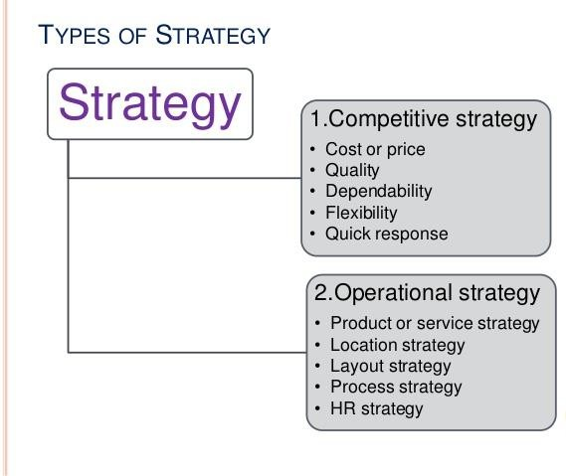

Slide 4
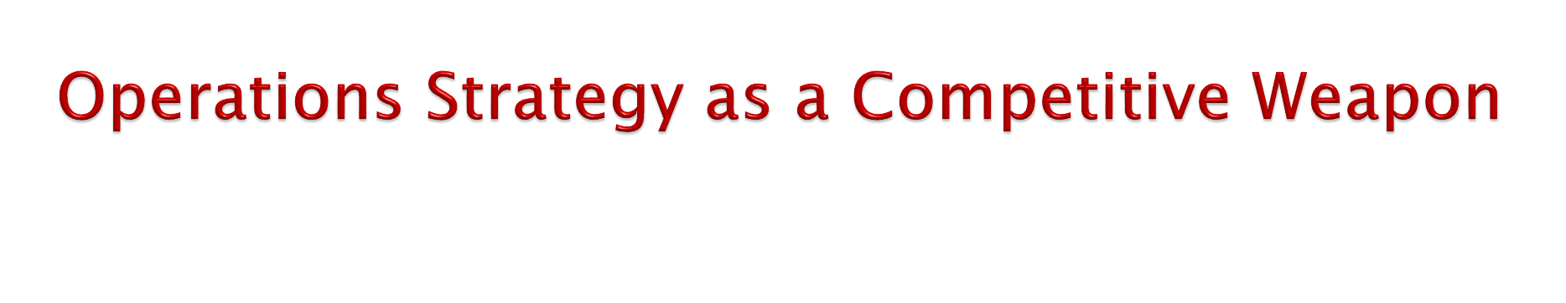
Operations strategy used as a competitive weapon for the purpose of organizational competitiveness.
Competitiveness is the degree to which a firm can produce goods and
services that meet the test of local markets.
The primary objective of the operations strategy (or Competitiveness) is to make the strong competitive position in the market for which quality products and services in lower price is very essential.
A firm’s competitiveness can be referred as its relative position in comparison to other firms in the local as well as global market. The main competitive dimensions of any firm are the quality and price.
Competitiveness can be increased with the effective use of its tools such as cost/price, quality, quick response, timing, differentiation etc.

Slide 5
1. Operations Strategies and Examples.
Factors | Operations Strategy | Examples of Companies or Services
Price | Low cost | U.S. first-class postage Wal-Mart Southwest Airlines
Quality | High-performance design and/ or high quality Consistent quality | Sony TV Lexus Disneyland Five-star restaurants or hotels Coca-Cola, PepsiCo Xerox, Motorola Electrical power
Time | Rapid delivery On-time delivery | Mc Donald’s restaurants Express Mail, UPS, FedEx One-hour photo Dominos Pizza FedEx Express Mail
Flexibility | Variety Volume | Burger King (“Have it your way”) Hospital emergency room Mc Donald’s (“Buses welcome”) Toyota Supermarkets (additional checkouts)
Service | Superior customer service | Disneyland Hewlett-Packard IBM Nordstrom
Location | Convenience | Supermarkets, dry cleaners Mall stores Service stations Banks, ATMs

Slide 6
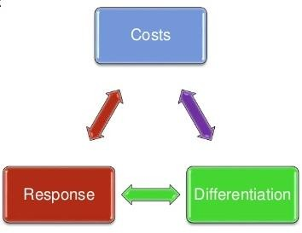
Three strategies provides (Costs, differentiation and response) an opportunity for operations managers to achieve competitive advantage in current situations.
Competitive advantage implies the creation of a system that has a unique advantage over competitors.
The idea is to create customer value in an efficient and sustainable
way.
Pure forms of these strategies may exist, but operations managers will more likely be called on to implement some combination of them.
Let us briefly look at how managers achieve competitive advantage via differentiation, low cost, and response.

Slide 7
1. Differentiation
Differentiation is more concerned about providing unique and innovative products, it should be regarded as going beyond products and service attributes to encompass everything that positively influences the value that customers derive from it.
This idea of differentiation creates customer experience as it serves as a bridge to engage customers.
In other words, uniqueness can go beyond both the physical characteristics and service attributes to encompass
everything that impacts customer’s perception of value.
Examples:
Walt Disney Magic Kingdom – experience differentiation
Hard Rock Cafe – dining experience

Slide 8
2. Low Cost
Low-cost leadership is about achieving maximum value from your customers’ viewpoint.
Low costs may provide the maximum value as perceived by customer. Does not imply low quality.
Examples:
Southwest Airlines – secondary airports, no
extra service charge, efficient utilization of equipment
Walmart – small overhead, shrinkage, and
distribution costs

Slide 9
3. Response
Response consists of being reliable, and capable of providing quick and flexible response.
Flexible response could be defined as the ability to quickly adapt to and keep up with the changes in the market place.
The idea of response also means that businesses need to be able to develop and deliver innovative products in a timely manner while creating customer value and experience.
Examples:
▶ Flexibility is matching market changes in design innovation and volumes - A way of life at Hewlett-Packard
▶ Reliability is meeting schedules -German Machine Industry
▶ Timeliness is quickness in design, production, and delivery -
Johnson Electric, Pizza Hut, Motorola

Slide 10

Strategy Hierarchy and Their Linkage
Strategy Hierarchy
Corporate Strategy
Business Units Strategy
Operations Strategy
Defines businesses in which the company will participate and plans for allocation of resources among them
Families of products with similar characteristics or methods of production
Decision, actions, roles, and activities of operations that contribute to and support the business strategy

Slide 11
Corporate Strategy
Corporate strategy defines the businesses in which a company will participate. It also develops plans for the acquisitions and allocation of resources among them. Corporate strategy considers environmental factors such as demand and availability of materials, labour, and capital. It also considers strengths and weaknesses of the competitors. Corporate strategy answers the following questions:
What businesses will a company be in? For example, a company
decides that its businesses will be automobiles, steel, and chemicals.
What parts of the world will a company operate in? For example, a company decides that it will focus on European markets.
What business will a company acquire and what businesses will it divest? For example, a company decides that it will acquire mini steel plants.
Business Unit Strategy
Strategic business units are families of products having similar characteristics or methods of production. They may be organized along broad materials lines, such as plastics, glass, or steel: or by consumer-product segments, such as snacks, beauty products, or healthcare products. The strategic business unit strategy is related to the following questions.

Slide 12
What will be the mission and objectives of each business of accompany? For example the mission of a company is to become the market leader in 25 percent of its country markets.
How will each business compete in its market? Will it focus on quality, service, speed of delivery, or price? For example, a company decides to compete on the speed of delivery.
How will each business deals with its environment? A company’s environment consists of its customers, competitors, and regulators. For example, a company decides that it will follow the price cut/increase by its major competitor.
Operations Strategy
Operations strategy comprises decisions, actions, roles, and
activities of operations that contribute to and support a company’s business strategy.
For example, if the corporate strategy is to serve mass customers with standard products at low prices, the operations functions installs a line flow to produce a standard product in large volumes at a low cost.

Slide 13

Operations strategies should be consistent with and promote and company’s overall goals. Companies should use their operations strengths as competitive weapons. Most successful companies base their strategies on what they can do well; their strategies are aligned with their operational strengths.
Major components of service strategies can be classified into following five
categories:
Product or Service Strategy
A company’s operations strategy is driven by the kind of products that it offers. Product or service strategy includes cost/price, quality, size and shape, features, looks etc. Product and service design should reflect joint efforts of many areas of the firm to achieve a match between financial resources, operations capabilities, supply chain capabilities, and consumer wants and needs. Products can be classified as make-to-order, make-to- stock, or assemble-to-order.
Location Strategy
Location strategy is another component of operation strategy. While developing location strategy, an operations manager should be able to analyze different factors like materials, manpower, customer or market, geographical structure, climate, local community, infrastructure etc. Location can be important in terms of cost and convenience for customers. Location near markets can result in lower transportation costs and quicker delivery times. Convenient location is particularly important in the retail sector.

Slide 14
Layout Strategy
Layout strategy is another component of operations strategy. Facility layout and design is an important component of a business's overall operations, both in terms of maximizing the effectiveness of the production process and meeting the needs of employees. The basic objective of layout is to ensure a smooth flow of work, material, and information through a system. The basic meaning of facility is the space in which a business's activities take place. The layout and design of that space impact greatly how the work is done— the flow of work, materials, and information through the system.
Process Strategy
Process strategy refers to the pattern of decisions made in managing processes with the aim of achieving competitive priorities. Processes understanding, development, evaluation, selection and implementation are the basic activities that are to be performed by an operations manager in the course of developing process strategy. In understanding process strategy, there are three main principles that are particularly important:
The key to successful process decisions is to make choices that fit the situation. They should not work at cross-purposes, with one process optimized at the expense of other processes. A more effective process is one that matches key process characteristics and has a close strategic fit.
Individual processes are the building blocks that eventually create the firm's whole supply chain.
Management must pay close attention to all interfaces between processes in
the supply chain, whether they are performed internally or externally.

Slide 15
As a manager or business owner, it is role to make sure that our processes are adding as much customer value as possible. Also, we must understand that many processes will cut across organizational lines, regardless of whether your business is organized along functional, product, regional or process lines. Processes can also cut across organizations, such as linking your business with our external suppliers and customers.
Each process must be designed to achieve competitive priorities and add value to the work performed. It is therefore necessary to have a solid process strategy in place if we want to effectively manage our supply chain.
Human Resource Strategy
A company’s human resource policies should be consistent with its choice of technology, process, and quality strategies. For example, it a company has decided that its products will be embedded with the latest technologies, it must have a policy of hiring and nurturing the best scientists and technologists. It must allow them to have greater control over their jobs and allow them to pursue their own interests.
Similarly, if a company expects its employees on the shop floor to make suggestions on how quality can be improved and cost can be reduced, it must train them and empower them.

Slide 16
Manufacturing Strategies
Manufacturing strategy as a concept was first recognized by Skinner (1969), referring to a manufacturing strategy as to exploit certain properties of the manufacturing function to achieve competitive advantages.
Hayes and Wheelwright (1984) describe manufacturing strategy as a consistent pattern of decision making in the manufacturing function linked to the business strategy.
Components of Manufacturing Strategy
Manufacturing Strategy
Competitive Priorities
Decision Categories

Slide 17
1. Competitive Priorities
The operations function helps strategy evolve by creating new and better ways of delivering a firm's competitive priorities to the customer. Once a firm's competitive priorities have been established, its operating system must be configured and managed to provide for those priorities. This involves a whole series of interrelated decision on products and services, processes and technology, capacity and facilities, human resources, quality, sourcing, and operating systems.
Competitive priorities define the set of manufacturing objectives and represents the link to market requirements. Dimensions commonly used are; cost, quality, flexibility, and delivery.
1. Competitive Priorities with Descriptions
Competitive Priorities | Description
Quality | Manufacture of products with high quality and performance standards.
Delivery | Reliable (on time) and fast(short delivery lead time) delivery of products
Cost | Production and distribution of the product at low cost
Flexibility | Ability to handle volume and product mix change

Slide 18
2 Decision Categories
Decisions in manufacturing related issues are often grouped into categories, usually denoted decision categories. Since Hayes and Wheelwright (1984) first presented the concept numerous authors have contributed to the development and establishment of the set of decision categories, and associated policy areas, normally used.
1. Decision Categories and Associated Policy Areas
Decision Categories | Policy Areas
Structural: Process choice Facilities Capacity Vertical integration | Process choice, technology, integration Size, location, focus Amount, timing, increments Direction, extent, balance
Infrastructural: Manufacturing Panning and control Performance measurement Organization Quality | System design, decision support, Measurements, methods of measures Human resources, design Definition, role, tools

Slide 19
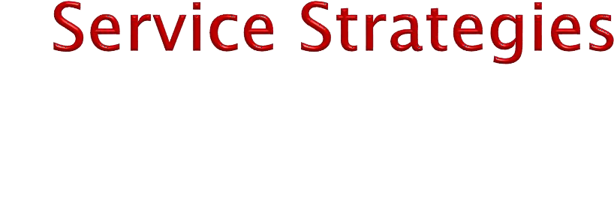
Service strategy is defined as the set of plants and policies by which a service organization aims to met its objectivities.
A strategy plan will harness the various aspect of an organization and ensure that they support each other and are consistent with the direction indicated by the drivers of change.
Five critical elements of strategy are: the creation of corporate objective, and understanding of the environment, the development of an appropriate service concept, the identification of appropriate operations performance objectives, and the development of an appropriate operation.

Slide 20
Five Key Components of Service Strategy
Operations Potential and Capability
Corporate Objectives
Parameters for Change
Operation
Environment
Operations Task
Opportunities
Performance Objectives
Service Concept

