Slide 1

Reasons and Importance of location decisions
Factors affecting location decision of service, and manufacturing organizations
Techniques of location analysis: Qualitative and quantitative analysis;
Concept on layout
Types of layout: Product layout , process layout , cellular layout , fixed position layout;
Designing process layout.

Slide 2

The need and importance of location decision often depends on the type of business.
For industrial location decisions, the strategy is usually minimizing costs, although innovation and creativity may also be critical.
For retail and professional service organizations, the location strategy
focuses on maximizing revenue.
Warehouse location strategy, however, may be driven by a combination of cost and speed of delivery.
Firms such as banks, fast-food chains, supermarkets, and retail stores view locations as part of marketing strategy, and they look for locations that will help them to expand their markets.
The objective of location strategy is to maximize the benefit of location to the firm.
Location decisions often have an impact in investment requirements, operating costs and revenues, and operations.
A poor choice of location might result in excessive transportation costs, a shortage of qualified labor, loss of competitive advantage, inadequate suppliers of raw materials, or some similar condition that is unfavorable to operations.

Slide 3
Some basic reasons/importance of location decision can
be highlighted with the help of following point:
Production and operating cost reductions
Quality and timely production are possible.
Helps in value and profits increment.
Helps in expanding their business or to set up new branches.
Helps in best utilization of available resources.
Helps in adopting changes and development of new
technology.
Helps in increasing goodwill or image of organization.
Helps in increasing competitiveness.
Helps in gaining competitive advantages.

Slide 4


Factors Affecting Location Decision
Selection of Region or Area
Selection of Community
Selection of the Site
Soil, Size and Topography
Easy Availability of Cheap Land
Transport Facility
Disposal of Waste Materials
Water Supply
Risk of Uncertainties etc.
Labour Facility
Quality of Life
Community & Labour Attitudes
Local Taxes and Restrictions
Finance and Research Facilities etc.
Availability of Raw Materials
Location of Markets
Labour Supply
Transportation Facilities
Climate and Taxes
Power Sources
Governmental Policies etc.

Slide 5
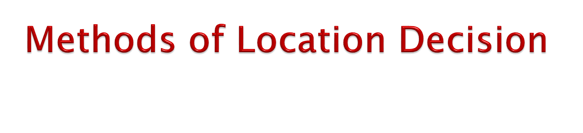
1. Simple Comparative Chart Analysis
Simple comparative chart is one of the techniques of analyzing intangible factors for selecting facilities location. The following steps should be followed:
Step 1: Recognize the critical intangible factors affecting location decision. For example: labour supply, business climate, community attitude, union activities, employee morale, competence of managers, reputation of enterprises, goods public relation.
Step 2: Compare and rank all alternative locations on the basis of these factors like good or bad, favourable or unfavourable, important or not important, etc.
Step 3: Select the best location for organization.
Intangible factors | Location A | Location B | Location C
Labour supply | Suitable | Suitable | Unsuitable
Business climate | Good | Good | Worst
Community attitude | Unfavourable | Favourable | Favourable
Union activities | Important | Less important | Important
Decision: On the basis of above simple comparative chart, location 'B' is selected as the best location than 'A' and 'C'.

Slide 6
2. Factor/Point Rating Method
Factor rating method is also used for evaluating wide range of
intangible factors associated importantly with location.
It is improved technique than simple rating method because simple comparative chart method does not break down factors into sub-factors but factor rating method breakdowns factors into sub-factors for evaluation and analysis.
Factor rating method is a kind of survey technique which follows
following steps:
Step 1: Identify the sensitive factors for location decisions. For example, direct materials, direct labour, power, taxes, insurance etc.
Step 2: Rate each factor from 1(very poor) to 5 (very good) according to their merit basis. For example, Factor rate – 4, 3, 2, 5, 1.
Step 3: Rate the alternative location from 1 (very low) to 10 (very high) according to their merits of each characteristics. For example, 10, 6, 8, 4, 2, so on.
Step 4: Multiply the factor rate and alternative location rate and find the total score of each alternative location.
Step 5: Select the location with highest score.

Slide 7
Analysis of Location under Factor Rating Method.
Factors | Location A |  |  | Location B
 | Factor Rate | Location Rate | Total | Factor Rate | Location Rate | Total
Direct Materials | 5 | 10 | 50 | 2 | 8 | 16
Direct Labour | 4 | 9 | 36 | 3 | 10 | 30
Climate | 3 | 7 | 21 | 4 | 7 | 28
Transportation | 2 | 5 | 10 | 5 | 5 | 25
Power | 1 | 4 | 4 | 1 | 3 | 3
Taxes | 5 | 2 | 10 | 2 | 2 | 4
Insurance | 4 | 1 | 4 | 3 | 4 | 12
Total |  |  | 135 |  |  | 118
Decision: From above analysis, location A is the best location because
it has the maximum score i.e. 135.

Slide 8
3. Centre Gravity Method
Centre of gravity or weight centre is a technique of quantitative method for locating a facility such as a warehouse at the centre of movement in a geographic are based on weight and distance.
It is a mathematical technique that can be used for locating a distribution centre that will minimize distribution cost.
This method identifies a set of coordinates designating a central location on a map relative to all other locations. This has following steps:
Step 1: Place location on a coordinate system.
Step 2: Determine the centre of gravity using following equations/formula:
X -Coordinate value = ^{Σ𝑿𝑾}
Σ𝑾
Y –Coordinate value = ^{Σ𝒀𝑾}
Σ𝑾
Where,
X, Y= Coordinates of existing facility.
W = Annual weight shipped from facility.

Slide 9
Example: A Himalayan Company is investigating which location could be best as a centre relative. Following are the information that has been collected for that purpose.
Location | XY-Coordinates (in miles) | Tons per year
A B C D | (10, 20) (20, 30) (5, 10) (20, 40) | 10 20 5 10
Identify the center gravity value.

Slide 10
Solution: Let’s identify the information for the requirement of formula given.
Location | XY- Coordinates (in miles) | Tons/ Year (W) | XW | YW
A B C D | (10, 20) | 10 | 100 | 200
 | (20, 30) | 20 | 400 | 600
 | (5, 10) | 5 | 25 | 50
 | (20, 40) | 10 | 200 | 400
 | Total | 45 | 725 | 1250
Now, applying formulas, we will get the results as:
X -Coordinate value = ^{Σ𝑿𝑾} = ^{𝟕𝟐𝟓} = 16.11
Σ𝑾 𝟒𝟓
Y –Coordinate value = ^{Σ𝒀𝑾} = ^{𝟏𝟐𝟓𝟎} = 27.78
Σ𝑾 𝟒𝟓
Decision: Calculated XY-coordinate value is (16.11, 27.78). Location B should be selected as a best location because calculated XY coordinate value is nearer to given XY coordinate value of Location B (16.11, 27.78 : 20, 30).

Slide 11
4. Least Cost /Locational Break-Even-Analysis (BEA)
Method
Least cost /Locational Break-even analysis is the use of cost- volume analysis to make an economic comparison of location alternatives.
By identifying fixed and variable costs and graphing them for each location, we can determine which one provides the lowest cost.
It is particularly useful when the operation manager wants to define the ranges over which each alternative is best.
Locational break-even analysis can be done mathematically or graphically.
The graphic approach has the advantage of providing the range of volume over which each location is preferable. The steps to locational break-even analysis are as follows:
Step 1: Determine the fixed and variable cost for each location.
Step 2: Plot the total cost for each location, with costs on the vertical axis of the graph and annual volume on the horizontal axis.
Step 3: Select the location that has the lowest total cost for the
expected production volume.

Slide 12
Example: Lalu, owner of Hallmark Shopping Mall, is considering three locations-Lajimpat, Baneshwor and Boudha. He wishes to find the most economical location for an expected volume of 2,000 units per year.
Location | Fixed cost($) | Variable cost ($)
Lajimpat | 30,000 | 75
Baneshwor | 60,000 | 45
Boudha | 1,10,000 | 25
Solution
For each of the three locations, total cost is calculated with 2000 units of volume of production.
We know,
Total cost = Fixed cost + Cost per unit × Volume of production.
For Lajimpat,
Total cost = $ 30000 + $75 × 2000 = $ 180,000

Slide 13
For Baneshwor,
Total cost = $60000 + $45 × 2000 = $150,000
For Boudha,
Total cost = $110000 + $25 × 2000 = $ 160,000
Hence, with an expected volume of 2000 units per year, Baneshwor provides the lowest cost location. So, Baneshwor is selected as best location.
Calculating the Cross-Over Point
For Lajimpat and Baneshwor 30000 + 75x = 60000 + 45x
or,
30x = 30000
x = 1000 units.
For Baneshwor and Boudha
60000 + 45x = 110000 + 25x
or,
20x = 50000
x = 2500 units

Slide 14
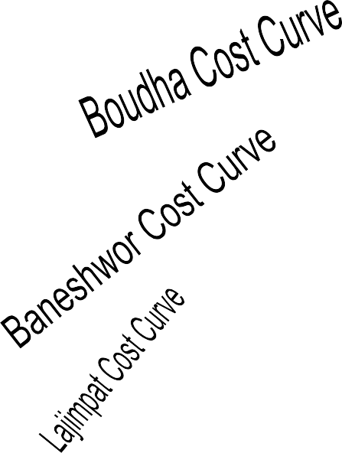
$ 180,000
$ 160,000
$ 150,000
$ 130,000
$ 110,000
80,000
60,000
$ 30,000
Total Cost
Lajimpat is best
Boudha is best
1000 1500 2000 2500 3000 3500
Baneshwor is best
$ 10,000
500
Expected Volume of Production Units

Slide 15
Summarized Table for Location Decisions
Volume range | Lowest cost location
0-999 units | Lajimpat
1000 Units | La or Ba
1001-2499 units | Baneshwor
2500 Units | Ba or Bou
≥ 2500 units | Boudha

Slide 16

Layout is the physical arrangement of plant or industrial facility in selected location either in existing or in new one. It is related to a number of aspects of production and operations management.
Layout is a method of allocation of department upon a site, workgroup and equipment within department, workstations, machines and stock- holding points within production facilities.
Therefore, it is concerned with configuration of department, work centers and equipment in the conversion process.
The plant layout is important due to following reasons:
Proper utilization of space or area.
Cost minimization and resource optimization.
Maintain and retain quality of goods and services.
Simplification of work complexity.
Safety and quality of work life for human and non-human physical
properties.

Slide 17

Repetitive Processing: Product Layouts / Line Layout
Product layout is an arrangement of facilities and equipment in the same sequence, as the order of the operations needed to complete each unit of the product, or the service offered.
Product layouts are used to achieve a smooth and rapid flow of large
volumes of goods through a system.
This is made possible by highly standardized goods that allow highly standardized, repetitive processing.
The work is divided into a series of standardized tasks, permitting specialization of equipment and division of labor.
The large volumes handled by these systems usually make it economical to invest substantial sums of money in equipment and job design.
For instance, if a portion of a manufacturing operation required the sequence of cutting, smoothing, and painting, the appropriate pieces of equipment would be arranged in that same sequence.
And because each item follows the same sequence of operations, it is often possible to utilize fixed-path material-handling equipment such as conveyors to transport items between operations.
For example: automobiles, sugar, steel, biscuit, soap etc. companies.
1.

Slide 18









Turning
operation
Milling
operation
Drilling
operation
Assembly
Packing
Welding
Inspection
Testing
Shipping
Advantages
Disadvantages
Less space for same volume of product in comparison to process layout.
It reduces the wastage due to continuous production.
Product completes in lesser time,
less inventory in process.
Once one machine is out of duty, all product process is interrupted.
Supervisors should be expert which
may raise cost.
One mechanism can produce single type of product once.

Slide 19
Non-repetitive Processing: Process Layouts/Functional Layouts
Process layouts (functional layouts) are designed to process items or provide services that involve a variety of processing requirements.
The variety of jobs that are processed requires frequent adjustments to equipment.
This causes a discontinuous work flow, which is referred to as intermittent processing.
Items that require those operations are frequently moved in lots or batches to the departments in a sequence that varies from job to job.
Consequently, variable-path material handling equipment (trucks, jeeps ) is needed to handle the variety of routes and items.
The use of general purpose equipment provides the flexibility necessary to handle a wide range of processing requirements.
Workers who operate the equipment are usually skilled or semiskilled.
For example: hospitals, banking and insurance, hotel and
restaurant, service centers etc.

Slide 20




















Emergency
Pharmacy
Patient out
Pediatrics
Gynecology
Operation Theater
OPD
Patient in
Neurology
Pharmacy
ECG
USG
X-Ray
Patient out
Patient out
Pathology
Advantages
Disadvantages
Flexibility of equipment and personnel.
Higher utilization of production facilities.
Variety of job makes the job
challenging and interesting.
Material handling cannot be mechanized which adds to cost.
Production planning and control is
difficult.
More space is required.
Lowered productivity due to number of set ups.

Slide 21
3. Fixed-Position Layouts
In fixed-position layouts, the item being worked on remains stationary,
and workers, materials, and equipment are moved about as needed.
In other words, fixed position layout is an arrangement of facilities and equipment, which facilities the flow of resources needed such as workers, equipment, materials, etc. to the term under production, or the item which is being serviced.
Almost always, the nature of the product dictates this kind of arrangement: Weight, size, bulk, or some other factor makes it undesirable or extremely difficult to move the product.
Fixed-position layouts are used in large construction projects (buildings, power plants, dams), shipbuilding, and production of large aircraft and space mission rockets.
Advantages
People can be assigned from starting to end of process.
It involves very longer movement of materials.
It ensures maximum flexibility of adjustments.
Disadvantages
It needs huge investments and very hard to co-ordinate people and machines.
It involves high equipment
handling cost.
It may not have easy maintenance service on spot (site).

Slide 22
Equipment A | Labour 1 | Labour 2 | Equipment C
 | Work Area Material | (fixed) Position
Equipment B |  |  | Equipment D
INDEX
Labour
Equipment Material
Facilities

Slide 23
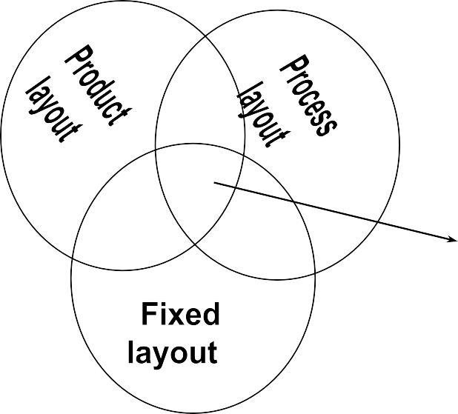


4. Combination Layouts
The three basic layout types are ideal models, which may be altered to
satisfy the needs of a particular situation.
It is not hard to find layouts that represent some combination of these pure types.
For instance, supermarket layouts are essentially process layouts, yet we find that most use fixed-path material-handling devices such as roller- type conveyors in the stockroom and belt-type conveyors at the cash registers.
Hospitals also use the basic process arrangement, although frequently patient care involves more of a fixed-position approach, in which nurses, doctors, medicines, and special equipment are brought to the patient.

Slide 24
5. Cellular Layouts
Cellular layout is a type of layout in which workstations are
grouped into what is referred to as a cell.
Groupings are determined by the operations needed to perform work for a set of similar items, or part families, that require similar processing.
All parts follow the same route although minor variations (e.g., skipping an operation) are possible.
Moreover, there is little effort or need to identify part families.
Cellular manufacturing enables companies to produce a variety of products with as little waste as possible.
A cell layout provides a smooth flow of work through the process with minimal transport or delay.
Benefits frequently associated with cellular manufacturing include minimal work in process, reduced space requirements and lead times, productivity and quality improvement, and increased flexibility.

