Slide 1

Concept of Aggregate Planning
Aggregate Planning Strategies
Planning Options
Aggregate Planning in Services.

Slide 2

Aggregate planning is concerned with determining the quantity and timing of production for the intermediate future, often from 6 to 18 months ahead.
Aggregate operations plan begins with a forecast of aggregate demand for the intermediate range by adjusting production rates, labour levels, inventory levels, overtime work, subcontracting rates and other controllable variables.
Aggregate planning covers the following issues and activities:
  Aggregate demand (estimation) of 6 to 18 months
  Aggregate supply (production) of 6 to 18 months
  Materials estimation
  Manpower requirement
  Productions units (including quality)
  Sub-contracting
  Productions shifts or schedules
  Backorder quantity
  Use of technology etc.

Slide 3
The aggregate plan is prepared to focus on a common course of action which consist the company's strategic goals and objectives.
Aggregate planning is necessary in production and operation management more, especially production process because of the following reasons:
  It reduces overall production costs.
  It optimizes the available resources
  Good policies, rules and regulations, strategies, etc. are prepared and implemented property.

Slide 4


Popularly, there are two types of approaches that are used to
develop production plan: aggregate plan and disaggregate plan.
Under aggregate planning approach, products are first classified as main product, family products and individual products (or units), analyzed every type of product in detail and production plan is developed.
But, under disaggregate planning approach, products are analyzed and plan is developed just taking any individual product.
MOTORBIKE
Main Product/Product Type
YAMAHA
BAJAJ
Family Product
Alba
FZS
Pulsar
Discover
Individual Product Or Unit

Slide 5
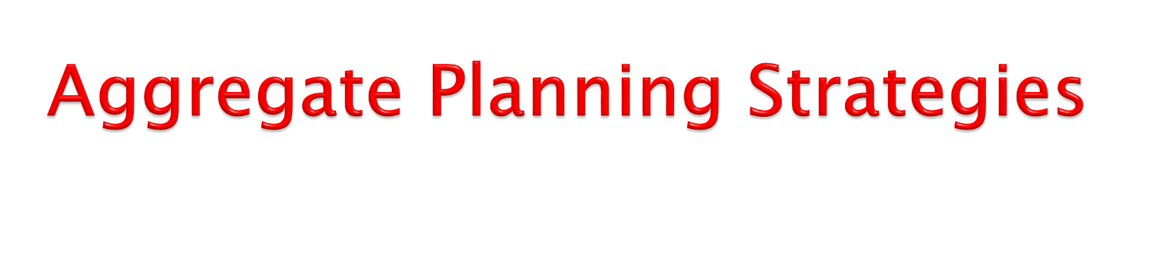
Aggregate planners may employ several strategies to meet expected customer demand.
The strategy that planners select should depend on the company's competitive priorities and the ways in which its product-service bundles add value for customers.
The various strategies that are used to absorb demand fluctuations are as follows:
  Level Production Strategy
  Chase Demand Strategy
  Peak Demand Strategy
  Mixed Strategy

Slide 6
Level Production Strategy
  In this strategy, a company produces at a constant rate which is defined by its capacity, and hence it is able to utilize its capacity well. It serves most of its demand at its lowest possible cost. It uses demand- modifying strategies such as differential pricing to shift demand from high-demand periods to low-demand periods (to reduce the peaks and troughs in demand) and then uses supply strategies such as inventory and subcontracting to match supply with demand.
  The level production strategy, ( As shown in figure below) sets production at a fixed rate, changes in the inventory account are used to balance mismatches between monthly demand and output. In this strategy, demand is met by altering only the inventory account. Workforce size, production rates, and subcontracting are held constant. During periods of low demand, over production is stored as inventory, to be depleted in periods of high demand. The cost of this strategy is the cost of holding inventory, including the cost of obsolete or perishable items that may have to be discarded.

Slide 7
1. Figure 6.4: Level Production Strategy
Demand
Production
Time
Units

Slide 8
Chase Demand Strategy
  In this strategy, a company produces to meet fluctuating demand, which essentially means that the company keeps extra capacity and the production rate is kept equal to the demand rate (As shown in figure below).
  This can be a good strategy in industries where incremental
costs of installing larger capacities are small.
  The chase demand strategy matches the production plan to the demand pattern and absorbs variations in demand by hiring and firing workers. In this strategy, demand is met by matching planned monthly production with forecasted demand, while the inventory account is held constant.
  During periods of low demand, production is increased and additional workers are hired. The cost of this strategy is the cost of hiring and firing workers. This approach would not work for industries in which worker skills are scarce or competition for labour is intense, but it can be quite cost effective during periods of high unemployment or for industries with low-skilled workers.

Slide 9
1. Figure 6.5: Chase Demand Strategy
Demand
Production
Time
Units

Slide 10
Peak Demand Strategy
  The peak demand strategy ensures high levels of customers’ service but can be very costly in terms of the investment in extra workers and machines that remain idle during low-demand periods. This strategy is generally used in service operations in which the immediate availability of customized service is critical. It is used when superior customer service is important or when customers are willing to pay extra forth availability of critical staff or equipment. The peak demand strategy is particularly appropriate in operations in which the product-service bundle is highly customized.
Mixed Strategy (Level +Chase)
  In this strategy, the demand rate is relatively constant; it does not change significantly from one time period to another. The company keeps some extra capacity, say, 20 percent of the average- demand. It mostly produces at a constant rate and uses inventory to serve any moderate increase in demand. But it is also, willing to produce during overtime. And if output is directly proportional to the number of employees on its rolls, it is also willing to hire and fire to match its production rate with the demand rate.

Slide 11
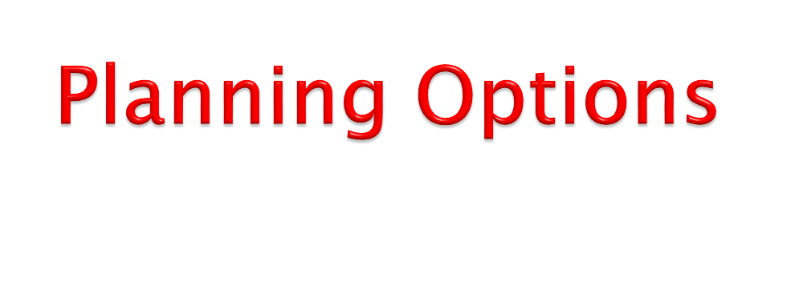
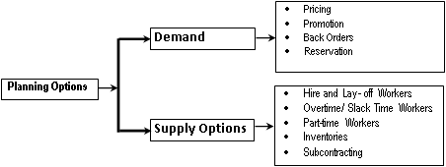
An aggregate planning process determines the resource capacity that a firm will need to meet its demand over an intermediate time horizon- 6 to 18 months in the future (as shown in figure below).
Aggregate planning options can be divided into two categories
as:
Demand Options
  Demand options can shift demand from peak periods to off-peak periods or create demand during off-peak periods so that the overall demand corresponds more closely to capacity in the planning horizon.

Slide 12
Pricing: A company uses differential pricing to reduce peak demand or increase the demand during low-demand periods. Higher price is charged when demand is high, and lower price is charged when demand is low. The idea is to shift demand from high-demand periods to low-demand periods so that demand is more even throughout the time period.
Promotion: A company advertises profusely during low- demand periods to stimulate demand and also to shift some demand from high-demand periods to low-demand periods. The timing of promotion efforts and knowledge of response rates and response patterns will be needed to achieve the desired results.
Back Orders: Back orders allow orders to be taken in one period and deliveries promised for a later period. The success of this approach depends on how willing customers are to wait for delivery. The costs associated with back orders are difficult to pin down and include lost sales, annoyed or disappointed customers, and perhaps additional paperwork.
Reservation: A company motivates its customers to reserve capacity. Customers promise to buy during some future time period. The company is able to know the demand in advance, and hence it is able to arrange capacity to meet the demand.

Slide 13
Supply/Capacity Options
  Capacity options allow planners to change supply by adjusting labor, inventory, and subcontracting.
Hire and Lay off Workers: The extent to which operations are labor intensive determines the impact that changes in the workforce level will have on capacity. Of the cost involved in this option, hiring cost includes recruitment, screening, and training to bring new workers "up to speed." And, quality may suffer. Some savings may occur if workers who have recently been laid off are rehired. Layoff costs include severance pay, the cost of realigning the remaining workforce, potential bad feelings toward the firm on the part of workers who have been laid off, and some loss of morale for workers who are retained.
Overtime / Slack Time: The use of overtime can be especially attractive in dealing seasonal demand peaks by reducing the need to hire and train people who will have to be laid off during the off-season. Moreover, in situations with crews, it is often necessary to use a full crew rather than to hire one or two additional people. It should be noted that some union contractors allow workers to refuse overtime. Some people may not appreciate having to work on short notice or the fluctuations in income. Overtime could also result in lower productivity, poor quality, more accidents, and increased payroll costs. Slack time can result in less efficient use of machines and other fixed assets. Some organizations use slack time for training. It also gives workers time for problem solving and process improvement, while retaining skilled workers.

Slide 14
Part-time Workers: The use of part-time workers depends on the nature of the work, training and skills needed, and union agreements. It costs less than regular workers in hourly wages and fringe benefits. Unions may regard such workers unfavorably because they typically do not pay union dues and may lessen the power of unions. Contract workers, also called independent contractors, have different pay scales and no benefits. They can be added or subtracted from the workforce with greater ease than regular workers, giving companies greater flexibility in adjusting the size of workforce.
Inventories: Inventory can be built up during periods when production capacity exceeds demand and drawn down in periods when demand exceeds capacity. Inventory involves holding or carrying those goods as inventory until they are needed. The cost is tied up that could be invested elsewhere. Additional cost includes insurance, obsolescence, deterioration, spoilage, breakage, and so on. Although services tend not to make use of inventories to alter capacity requirements, a portion of the services can be done during slack periods (e.g., organize the workplace).
Subcontracting: Subtracting enables planners to acquire temporary capacity with great flexibility. Factors to consider include availability capacity, relative expertise, quality considerations, cost, and the amount and stability of demand. As an alternative to subcontracting, an organization might consider outsourcing: contracting with another organization to supply some portion of the goods or services on a regular basis.

Slide 15
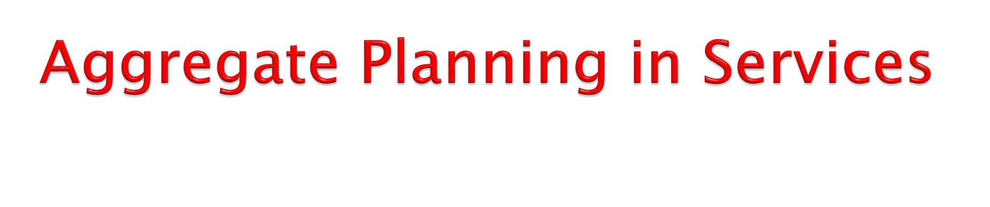
Some service organizations conduct aggregate planning in exactly the same way as manufacturing sector, but with demand management taking a more active role.
Aggregate planning for services takes into account projected customer demands, equipment capacities, and labor capabilities.
The resulting plan is a time-phased projection of service staff requirements.
Aggregate planning for manufacturing and aggregate planning for services share similarities in some respect, but there are some important differences-related in general to the differences between manufacturing and services:
  Capacity is difficult to predict
  Demand for service can be difficult to predict
  Services occur when they are rendered
  Labour flexibility can be an advantage in services
  Service capacity is designed and provided at the
appropriate place and time

Slide 16
The following are some observations on aggregate planning in a variety of services (Stevenson, W.J.; 2012):
Hospitals: Hospitals use aggregate planning to allocate funds, staff, and supplies to meet to take into account a wide range of factors (planes, flight personnel, ground personnel) and multiple routes and landing/departure sites. Also, capacity decisions must take into account the percentage of seats to be allocated to various fare classes in order to maximize profit or yield.
Restaurants: Restaurants aggregate planning in the case of a high- volume product output business such as a restaurant is directed towards smoothing the service rate, determining the size of the workforce, and managing demand to match a fixed capacity. The general approach usually involves building inventory during slack periods and depleting it during peak period.
Airlines: Airlines and auto-rental firms also have unique aggregate scheduling problems. Consider an airline that has it headquarters in New York, two hub sites in cities such as Atlanta and Dallas, and 150 offices in airports, throughout the country. This planning is considerably more complex than aggregate planning for a single site or even for a number of independent sites.
Other Services: Financial, hospitality, transportation, and recreation services provide a high-volume, intangible output. Aggregate planning for these and similar services involves managing demand and find ways to effectively use labor resources during periods of low demand.

