Slide 1

Concept or Nature of Inventory
Importance of Inventory
Inventory Costs
Dependent and Independent Demand
Inventory System: Continuous and Periodical
Basic EOQ Models (with and without discount)
ABC Classification

Slide 2
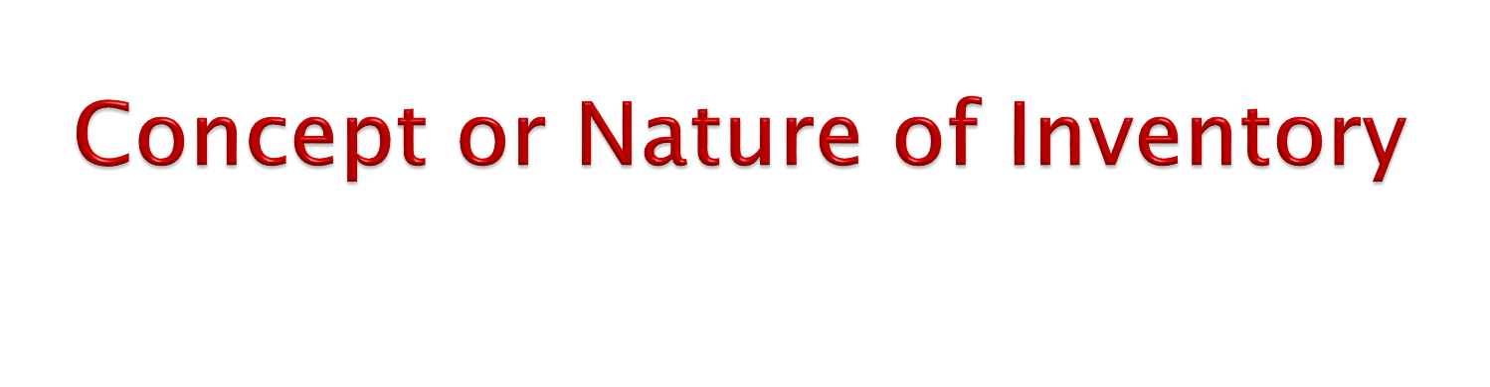
Inventory is a stock or store of goods.
Firms typically stock hundreds or even thousands of items in inventory, ranging from small things such as pencils, paper clips, screws, nuts, and bolts to large items such as machines, trucks, construction equipment, and airplanes.
Inventories are a vital part of business. Not only are they necessary for operations, but they also contribute to customer satisfaction.
In other words, inventory generally refers to the materials in stock. It is also called the idle resource of an enterprise.
Inventories represent those items which are either stocked for sale or they are in the process of manufacturing or they are in the form of materials which are yet to be utilized.

Slide 3
Inventory decisions in service organizations can be critical in comparison to manufacturing organizations. Hospitals, for example, carry an range of drugs and blood supplies that might be needed on short notice.
The different kinds of inventories include the following:
Raw materials and purchased parts.
Partially completed goods, called work-in-process
Finished-goods inventories (manufacturing firms) or merchandise (retail stores).
Tools and other supplies.
Maintenance and repairs inventory.
(WIP).
Goods-in-transit to warehouses, distributors, or customers (pipeline inventory).
Inventory control is a planned approach of determining what to order, when to order and how much to order and how much to stock so that costs associated with buying and storing are optimal without interrupting production and sales.

Slide 4
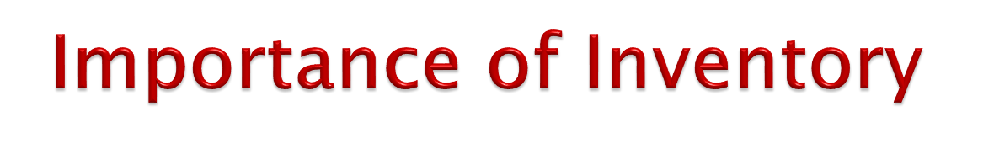
Need or importance of inventories can be explained with the help of following points:
To Take Advantage of Price Discounts
Usually the manufactures offer discounts for bulk buying and to gain this price advantage the materials are bought in bulk even though it is not required immediately. Thus inventory is maintained to gain economy in purchasing.
To Stabilize Production
The demand for an item fluctuates because of the number of factors. E.g. seasonally production schedule etc. The inventories (raw materials and components) should be made available to the production as per the demand failing which results in stock out and the production stoppage takes place for want of materials. Hence, the inventory is kept to take care of this fluctuation so that the production is smooth.
To Prevent Loss of Orders (Sales)
In this competitive scenario, one has to meet the delivery schedules at 100% service level, means they cannot afford to miss the delivery schedule which may result in loss of sales. To avoid this organizations have to maintain inventory.

Slide 5
To Meet the Demand During the Procurement Period The lead time for procurement of materials depends upon many factors like location of the sources, demand supply condition etc. So inventory is maintained to
meet the demand during the procurement period.
To Keep Pace with Changing Market Conditions The organizations have to anticipate the changing market sentiments and they have to stock materials in anticipation of non availability of materials or sudden
increase in prices.
Others
Sometimes the organizations have to stock materials due to other reasons like suppliers minimum quantity condition, seasonal availability of materials or sudden increase in prices.

Slide 6

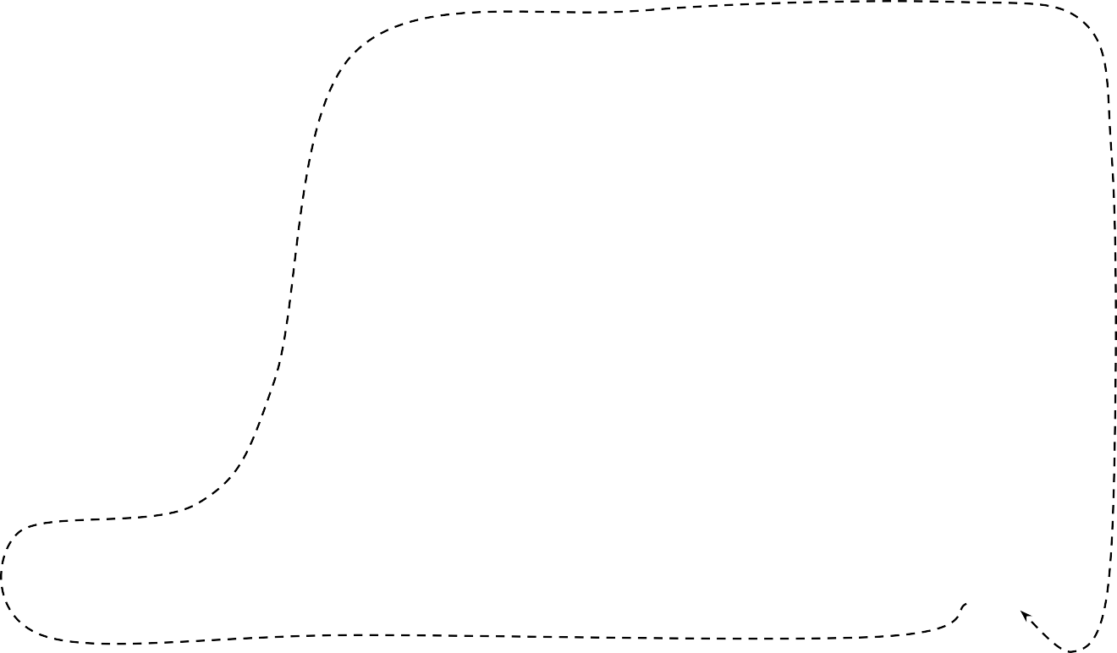









Factory
Warehouses
Suppliers
Lead Time
Ordering Cost or Setup Cost
Stores
Carrying Cost or Holding Cost
Customers

Slide 7
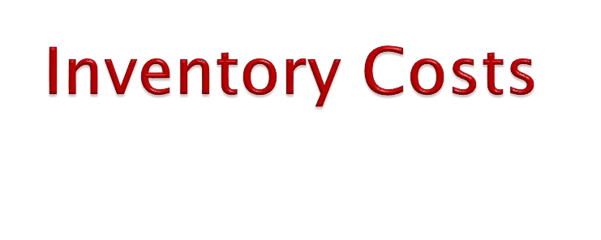
Purchase (or Production) Cost
The value of an item is its unit purchasing (production) cost. This cost becomes significant when availing the price discounts. This cost is expressed as Rs/ unit.
Ordering Cost
It is also known by the name procurement cost or replenishment cost or acquisition cost. Cost of ordering is the amount of money expended to get an item into inventory. This takes into account all the costs incurred from calling the quotations to the point at which the items are taken to stock. Ordering costs are generally classified under the following heads:
Purchasing: The clerical and administrative cost associated with the purchasing cost of requisitioning material, placing the order, follow-up, receiving and evaluating quotations.
Inspection: The cost of checking material after they are received by the supplier for quantity and quality and maintaining records of the receipts.
Accounting: The cost of checking supply against each order
making payments and maintaining records of purchases.

Slide 8
Inventory Carrying Costs (Holding Costs)
These are the costs associated with holding a given level of inventory on hand and this cost vary in direct proportion to the amount of holding and period of holding the stock in stores.
The holding costs include:
Storage costs (rent, heating, lighting etc.)
Handling costs: Costs associated with moving the items such as cost of labour, equipment for handling.
Depreciation, Taxes and insurance.
Costs on record keeping.
Product deteriorations and obsolescence.
Spoilage, breakage, pilferage and loss due to perishable nature.

Slide 9
Shortage Costs
When there is a demand for the product and the item needed is not in stock, then we incur a shortage cost or cost associated with stock out.
Then storage costs include:
Backorder costs.
Loss of future sales.
Loss of customer good will.
Extra cost associated with urgent, small quantity ordering costs.
Loss of profit contribution by lost sales revenue.

Slide 10
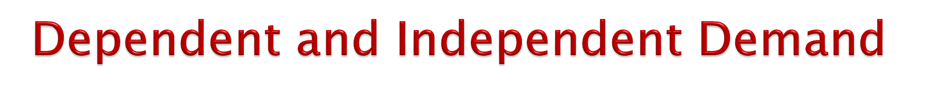
Demand for items in inventory is either dependent or independent. Dependent demand is related to the demand of another product. In other words, dependent demand items are typically component parts or materials used in the process of producing a final product. When a product is built up from components, the demand for these components is dependent on the demand of the product. Therefore, it a company plans to make 1,000 cars, the supplier who suppliers tires would make plans to supply 4,000 tires. If an automobile company plans to produce 1000 new cars, then it will need 5000 wheels and tires (including spares).

Slide 11
In an independent demand situation, stock is not directly dependent upon orders for finished products. The decision to purchase more quantities of stock is dependent on the stock itself. Car, retail items, grocery products, and office supplies are example of independent demand item. Independent demand items are final or finished products that are not a function of, or dependent on, internal production activity. Independent demand is usually determined by external market conditions and, thus, is beyond the direct control of the organization. In this chapter we focus on the management of inventory for independent demand items (Russell and Taylor, 2009).

Slide 12
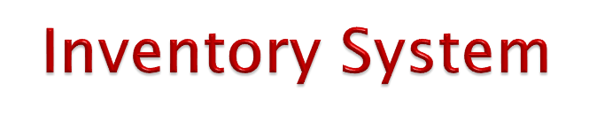
Periodical Inventory System (P-model)
In this, the stock position of each item of material is regularly reviewed.
Under this system, inventory is counted in fixed time interval (T) to determine the quantity of inventory to place an order (Q).
In this system, order quantity (Q) depends on the actual quantity of
period.
Inventory levels (Q)
Base stock level
Q₃
Q₄
Q₁
Q₂
0
T
2T
Time (T)
3T
4T

Slide 13
2. Continuous Inventory System/Perpetual Inventory System (Q-model)
In this model or system, a fixed quantity of material is ordered whenever the stock on hand reaches the reorder point.
The fixed quality of material ordered each time is nothing
but the economic order quantity (EOQ).
In other words, this system first of all determines the fixed order quantity Q, and reorder stock level ROL.
Fixed order may be in units or amount but the reorder level should be in the units.
In other words, order quantity of stock Q, and the level of stock ROL, at which level the order should be placed is predetermined.
Therefore, it is also called fixed order quantity or perpetual inventory system or economic order quantity model (EOQ) or Q/R model.

Slide 14
MSL
Maximum Stock Level
Inventory levels (Q)
Q₁
Q₂
Q₃
Q₄
ROL
0
LT
LT₂
LT₃
LT₄
Time

Slide 15
Table : Distinction Between ‘Q’ System and ‘P’ System
Basis | Q - System | P- System
Initiation of order. | Stock on hand reaches to reorder point | Based on fixed review period and not stock level.
Period of order | Any time when stock level reaches to reorder point. | Only after the predetermined period.
Record keeping. | Continuously (perpetual system) each time a withdrawal or addition is made | Only at the review period.
Order quantity. | Constant the same quantity ordered each time. | Quantity of order varies each time order is placed
Size of inventory | Less than the ‘P’ system. | Larger than the Q system.
Time to maintain. | Higher due to perpetual record keeping | Less time due to only at the review period.

Slide 16
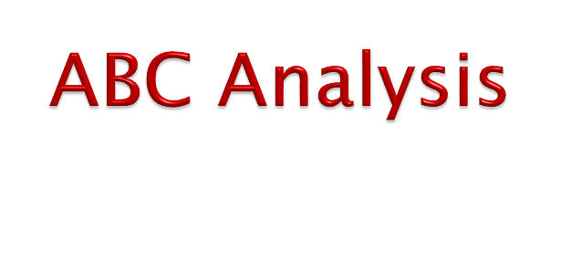
The inspiration behind the ABC analysis has been drawn from V. Pareto, an Italian economist and sociologist (1842-1923) who generated some highly debatable concepts of economics and sociology.
One of the widely used techniques for control of inventories is the ABC (always better control) analysis.
The ABC approach is a means of categorizing inventory items into three classes ‘A’, ‘B’ and ‘C’ according to the potential amount to be controlled.
Once inventory is classified, logically, we expect to maintain strong controls over the ‘A’ items taking whatever special actions needed to maintain availability of these items and hold stocks at the lowest possible levels consistent with meeting demands.
At the B category, we cannot afford the expenses of rigid controls, frequent ordering, expediting, etc., because of the low amounts in this area.
With the ‘C’ group we may maintain somewhat higher safety stocks, order more months of supply; expect lower levels of customer service, or all the three.
It is for selective approach, ABC analysis is often called the
Selective Inventory Control Method (SIM).

Slide 17
Category | % of Items (approx.) | % of Value (approx.)
A = High value items | 15 | 65
B = Medium value items | 20 | 25
C = Low value items | 70 | 10
A items | B items | C items
1. Very strict control | 1. Moderate control | 1. Loose control
2. No safety stocks (or very low) | 2. Low safety stocks | 2.High safety stocks
3. Frequent ordering | 3. Once in 3 months | 3. Bulk ordering
4. Weekly control statements | 4. Monthly control statements | 4. Quarterly reports
5.Maximum follow-up | 5.Periodic follow-up | 5. Follow-up in exceptional
6. Rigorous value analysis | 6. Moderate value analysis | 6. Minimum value analysis.
7.Accurate forecasts in materials planning | 8. Estimates based on past data | 8. Rough estimates
9. Minimization of waste, obsolete, and surplus (review every 15 days) | 9. Quarterly review | 9. Annual review
10. Individual postings | 10.Small group postings | 10. Group postings
11.Central purchasing and storage | 11. Combination purchases | 11.Decentralized purchasing
12. Maximum efforts to reduce lead time | 12. Moderate | 12. Minimum efforts
13.To be handled by senior officers. | 13. To be handled by middle management. | 13. Can be fully delegated.

Slide 18
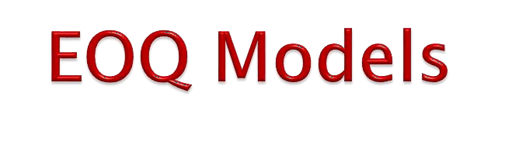
1. Economic Order Quantity (EOQ)/Optimum
Order Quantity
EOQ = ^{2𝐴𝑂} = … Units
𝐶
2. Optimum Number of Orders/Order frequency (N) =
𝐴
….Times
𝐸𝑂𝑄
3. Total Costs
(i) If discount rate or price-break condition is
not given
TC =
𝐴
× O + ^{𝐸𝑂𝑄} × C = Rs….
𝐸𝑂𝑄 2
(ii) If price-break condition is given
TC = A × PP +
𝐴
× O + ^{𝐸𝑂𝑄} × C = Rs….
𝐸𝑂𝑄
2
(iii) If discount rate is given
TC = A × PP + ^{𝐴} × O + ^{𝐸𝑂𝑄} × C) – (A × PP × DR) = Rs….
(
𝐸𝑂𝑄 2

Slide 19
4. Re-Order Level/Re-Order Point (ROL/ROP)
ROL = Daily Requirements × Lead Time +
Safety Stock = …Units Stocks = …Units
(i)
ROL =
𝐴
× Lead Time + Safety
(ii)
𝑊𝑜𝑟𝑘𝑖𝑛𝑔 𝐷𝑎𝑦𝑠
5. Average Stock Level
= Minimum Stock Level or Safety Stock + ^{𝐸𝑂𝑄} = …Units
2
6. Length of Inventory/Inventory Cycle/Cycle Time/Time Between the
Orders
₌ 𝑊𝑜𝑟𝑘𝑖𝑛𝑔 𝑑𝑎𝑦𝑠 𝑜𝑟 𝑊𝑒𝑒𝑘𝑠 _{= …Days/Weeks}
𝑁
Where,
A= Annual requirements/demands/needs
O = Ordering cost per order/Set-up cost per run
C = Carrying cost per unit/ holding cost per unit (based on PP) PP = Purchase Price/unit cost/inventory value
DR = Discount rate

Slide 20
Example 1: XYZ Company requires 12,000 units of material annually. If ordering costs are Rs. 250 per order, expected lead time is 5 days, unit cost is Rs. 25 per unit and annual inventory holding costs are charged at 20% and the company operates 250 days a year, compute, EOQ, T, N, TC at ROL, total annual cost and ROL.
Solution
Given,
Annual requirement (A) = 12,000 units
Ordering cost per order (O) = Rs. 250 Units cost of item (P) = Rs. 25
Lead time (L) = 5 days
Annual carrying cost per unit (C) = 20% of Rs. 25 = Rs. 5
Number of working days in a year (n) = 250 days.
(i) Calculation of Economic Order Quantity (EOQ)
EOQ =
2𝐴𝑂 ₌
^{2×12000×250} = 1095.5 Units
𝐶
5

Slide 21
Calculation of optimal length of inventory cycle (T)
T = n × ^{EOQ} × 365 = 250 × ^{1095.5} = 22.82 ≈ 23 days
A
12,000
Calculation of optimum number of order (N)
N = ^{A} = ^{12,000} = 10.95 ≈ 11 times
EOQ 1095.5
Calculation of total cost at EOQ (TC)
TC = ^{A} × O + ^{EOQ} × C = ^{12,000} × 250 + ^{1,095.5} × 5 = 2,738.75 + 2,738.75 = Rs. 5,477.50
EOQ 2
1,095.5
2
Calculation of re-order level (ROL)
ROL= ^{A} × Lead time + Safety stock = ^{12,000} × 5 + 0 = 240 units Working days in a year 250

Slide 22
Calculation of total annual cost (TC)
TC = A × P + ^{A} × O + ^{EOQ} × C
EOQ 2
= 12,000 × 25 + ^{12,000} × 250 + ^{1,095.5} × 5
1,095.5
2
= 300,000 + 2,738.75 + 2,738.75 = Rs. 305,477.5
Example 2
A firm requires 1,00,000 units in year. Cost of placing order is Rs. 800 carrying cost is 2% of the item cost. Cost per unit is Rs. 12 if ordered up to 24,999 units, Rs. 10 if ordered 25,000 units to 40,000. Identify optimum order quantity and
total cost.

Slide 23
Solution Given,
Annual requirements (A) = 100,000 units Ordering cost (O) = Rs 800
Order size | Price
≤ 24,999 25,000 – 40,000 | 12 10
Calculation of EOQ for 24999 units and less order size is,
EOQ =
2AO ₌ 2 × 100,000 × 800 ₌ 160,000,000 _{= 25819 units}
C 2% of 12 0.24
Condition is not satisfied, required order size (OS or EOQ) = 24,999 units
Total costs = Total carrying cost + Total order cost + Purchase cost
= ^{EOQ} × C + ^{A} × O + A × PP
2 EOQ
= ²⁴⁹⁹⁹ × 0.24 + ^{100,000} × 800 + 100,000×12
2 24999
= 2999.98 + 3200.128 + 1,200,000
= Rs 1206200

Slide 24
Calculation of EOQ for “25000 – 40000” order size
Again,
2AO ₌ 2 × 100,000 × 800 ₌ 160,000,000 _{= 28284 units}
C 2% of 10 0.2
EOQ =
Total costs = Total carrying costs + Total ordering cost + Purchase cost
= ^{EOQ} × C + ^{A} × O + A × PP = ²⁸²⁸⁴ × 0.2 + ^{100,000} × 800 + 100,000 × 10
2 EOQ 2 28284
= 2828.4 + 2828.4 + 1,000,000
= Rs 1005656.85
Conclusion: Optimum order quantity is “25000 – 40000” order size as it has minimum cost (i.e. 1005656.85 < 1206200).

Slide 25
Example 3: A company purchased 2000 units of a particular item per year at a unit cost of Rs 20. The ordering cost is Rs 50 per order, and the inventory carrying cost is 25%. Find the optimal order quantity. If a 3% discount is offered by the supplier on lots of 1000 or more, should the company accept the offer?
Solution:
Given
Annual requirement (A) = 2,000 units Ordering costs (O) = Rs. 50
Purchase price (PP) = Rs. 20
Carrying Costs (C) = 25% of Rs. 20 = Rs. 5
Calculation of optimum order quantity (EOQ)
EOQ =
2𝐴𝑂 ₌
2×2000×50 _{= 200 Units}
𝐶
5
Now, for the decision, total costs should be calculated under both conditions (i.e., EOQ and offering units)
TC at EOQ = TC = A × PP + ^{𝐴} × O + ^{𝐸𝑂𝑄} × C) – (A × PP × DR) = Rs….
(
𝐸𝑂𝑄 2

Slide 26
TC = 2000 × 20 + (²⁰⁰⁰ × 50 + ²⁰⁰ × 5) – (2000 × 20 × 0) = Rs. 41,000
200 2
Again,
TC at Offering Units = A × PP + (^{𝐴} × O + ^{𝑄} × C) – (A × PP × DR) = Rs….
𝑄 2
TC = 2000 × 20 + (²⁰⁰⁰ × 50 + ¹⁰⁰⁰ × 5) – (2000 × 20 × 0.03)
1000 2
= Rs. 41,400
Decision: discount offer should not be accepted by the company because total cost under offering units is more than that of EOQ (i.e., Rs. 41,400 > Rs. 41,000).

Slide 27
Numerical Problems for the Practices Problem – 1
The ABC company requires 1000 units per month through the year at constant rate. If ordering cost are Rs 250 per order, unit cost of the item is Rs 25 and annual inventory holding cost are charged at 20%, their determine the EOQ
for the item.
[Ans: EOQ = 1095.45]
Problem – 2
Alina Bakery uses an average of 20 kg wheat per day. It operates 300 days a year. Storage and handling costs for the wheat are Rs 5 per year per kg and it costs approximately Rs 150 to order and receive a shipment of wheat. Calculate:
EOQ
Total annual cost
Reorder level if desired safety stock 400 kg, lead time 10 days.
[Ans: EOQ = 600 units, Total Annual Cost = Rs. 3,000, and ROL = 600 units]

Slide 28
Problem – 3
Assume you have a product with the following parameters:
Demand = 360
Holding cost per year = $ 1.00 per unit
Order cost = $ 100 per order
Delivery lead time = 15 days
What is the EOQ? Assuming a 300-day work year; how many orders should be processed per year? What is the expected time between orders? What is the total cost for the inventory policy? What may be ROL?
[Ans: EOQ = 268 items, Number of orders = 1.34 per year, Expected time between the order = 224 days, Total cost = $268 and ROL = 18 units]
Problem – 4
For a given item of constant demand rate, the yearly demand is 70,000 units. The price of the item per units is Rs. 50. The ordering cost is Rs. 200 per order and the inventory carrying cost is 40% p.a. What is the optimal ordering policy? The vendor offers 1% discount if 1500 units are purchased at a time. Do you accept the discount offer?
[Ans: Discount offer should be accepted]

Slide 29
Problem – 5
For a given item, there is constant demand rate. Annual demand is 60,000 nos. the price per item is Rs. 30. The ordering cost is estimated as Rs. 300 per order and inventory carrying cost is 30% per annum. What should be the optimal ordering quantity? If 3000 units purchased at time, a discount of 5% on unit price, is offered by the supplier. Do you accept this offer?
[Ans: EOQ = 2000 units, Discount offer should be accepted]
Problem – 6
We need 1,000 electric drills per year. The ordering cost for these is $100 per order and the carrying cost is assumed to be 40% of per unit cost. In orders of less than 120, drills cost $78; for orders of 120 or more, the cost drops to $50 per unit. Should we take advantage of the quantity discount?
[Ans: Optimum order quantity = 120 units with total and minimum cost of Rs. 52, 033]

Slide 30
Problem –7
A supplier for St. LeRoy Hospital has introduced quantity discounts to encourage larger order quantities of a special catheter. The price schedule is:
Order Quantity | Price per unit
0 to 299 | $60.00
300 to 499 | $58.80
500 or more | $57.00
The hospital estimates that its annual demand for this item is 936 units, its operating cost is $45.00 per order, and its annual holding cost is 25 percent of the catheter’s unit price. What quantity of this catheter should the hospital order to minimize total costs? Suppose price for quantities between 300 and 499 is reduced to $58.00. Should the order quantity change?
[Ans: EOQ₅₇ = 77 units, TC₅₇ = $57,284, EOQ_{58.8} = 76 units, TC₃₀₀ = $57,382, EOQ₆₀ = 75 units, TC₅₀₀
= $56,999, optimum order quantity = 500 units]

Slide 31
Problem – 8
ABC company proposes to buy an item for which the annual demand is 2,000 units. The ordering cost is estimated at Rs. 25 per order and the inventory carrying costs are charged at 30% p.a. The price schedule quoted by the supplier is as below:
Order Quantity | Price per Unit (Rs.)
1 to 99 100 to 499 500 & above | 50 45 40
What is the optimal order quantity?
[Ans: Optimum order quantity = 500 units and TC₅₀₀ = Rs 83,100]

