Slide 1
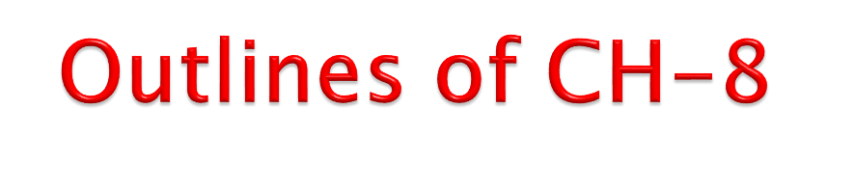
Introduction to Quality
Historical evolution of Total Quality Management
Definitions of Total Quality Management (TQM)
Philosophy (Principles) of Total Quality Management
Costs of Quality
Quality Control: Introduction, Objectives, Advantages
Statistical Process Control –Control Charts for Variables and
Attributes;
Just-in-Time (JIT)
Six Sigma
Quality Management System: ISO 9000 Series
7 Tools for the Quality

Slide 2
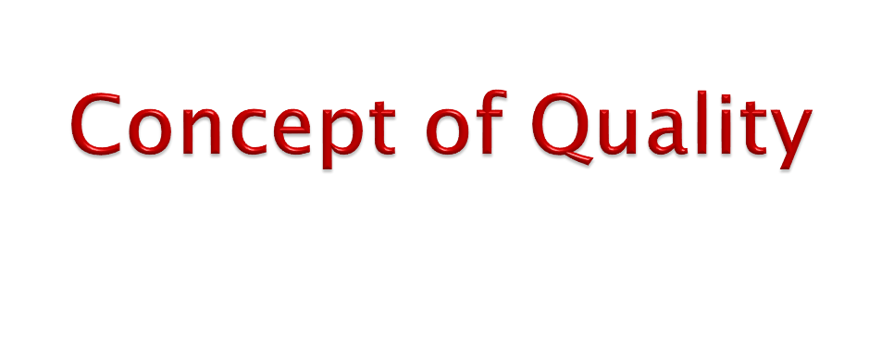
When the expression "quality" is used, we usually think in terms of an excellent product or service that fulfills or exceeds our expectations.
In other words, the quality refers to the ability of product or service to consistently meet or exceed customer requirements or expectations.
In other words, quality may be defined as the sum total of features
of a product which influence its ability to satisfy a given demand.
Basically, the quality of products and services is not defined or
determined by producing firms, it is determined by customers.
The quality of product or service is a customer‘s perception of the degree to which the product or service meets his or her expectations.
When a product surpasses our expectations we consider that quality. Thus, it is somewhat of an intangible based on perception.

Slide 3
Quality can be quantified as follows:
𝑷
Q ≥
𝑬
Where,
Q = quality , P = performance, E = expectations
If Q is greater than 1.0, then the customer has a good feeling about
the product or service.
Of course, the determination of P and E will most likely be based in perception with the organization determining performance and the customer determining expectations.
Few definitions given by experts are:
―Quality is a customer‘s perception‖-E. Deming
― Quality is a fitness for use‖ – J. Juran
― Quality is a readiness to pay and conformity to requirements‖- P.Crosby

Slide 4
Year | Concepts or Theories
1920s | Some of the first seeds of quality management were planted as the principles of scientific management swept through U.S. industry. Businesses clearly separated the processes of planning and carrying out the plan, and union opposition arose as workers were deprived of a voice in the conditions and functions of their work. The Hawthorne experiments in the late 1920s showed how worker productivity could be impacted by participation.
1930s | Walter Shewhart developed the methods for statistical analysis and control of quality
1950s | W. Edwards Deming taught methods for statistical analysis and control of quality to Japanese engineers and executives. Joseph M. Juran taught the concepts of controlling quality and managerial breakthrough. Armand V. Feigenbaum’s book Total Quality Control, a forerunner for the present understanding of TQM, was published. Philip B. Crosby’s promotion of zero defects paved the way for quality improvement in many companies
1960s | The Japanese named their approach to total quality companywide quality control. Kaoru Ishikawa’s synthesis of the philosophy contributed to Japan’s ascendancy as a quality leader
Since 1970s | TQM is the name for the philosophy of a broad and systemic approach to managing organizational quality. Quality standards such as the ISO 9000 series and quality award programs such as the Deming Prize and the Malcolm Baldrige National Quality Award specify principles and processes that comprise TQM.

Slide 5
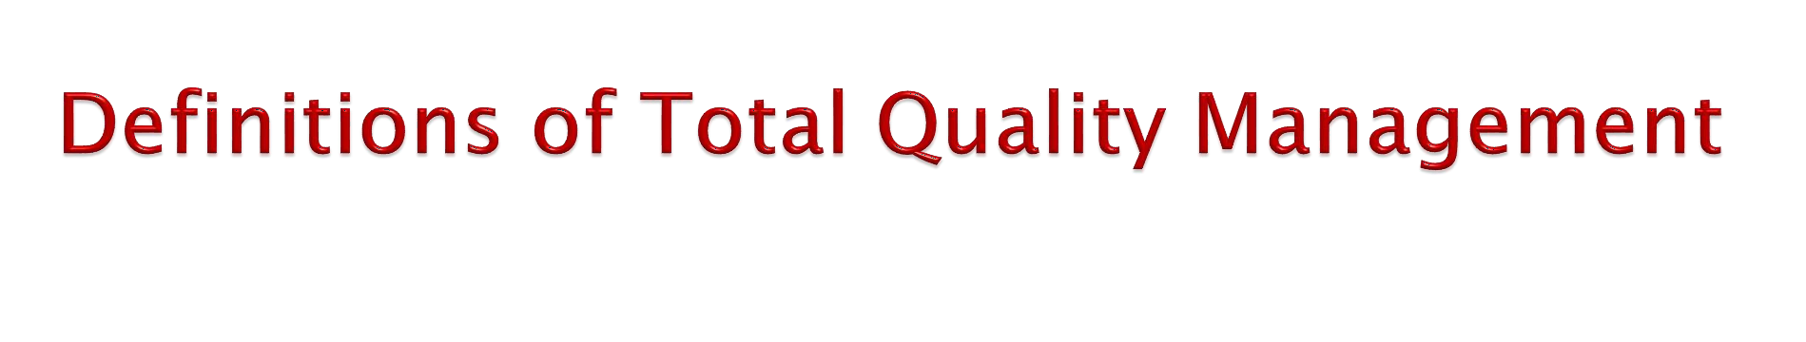
TQM is for the most part common sense. Analyzing the three words, we
have:
Total – Made up of the whole
Quality – Degree of excellence a product or service provides Management – Act, art, or manner or handling, controlling, direction etc.
Therefore, TQM is the art of managing the whole to achieve excellence.
Total Quality Management (TQM) is a major recent development in production and operations management. Though practiced in 1980s, TQM became truly pervasive in the 1990s.
Many firms are now adopting a total quality management approach to their business.
Under this approach, the entire organization from the president or chief executive officer down to the lowest level employee are committed and involved in never-ending quest to improve the quality of outputs (continuous improvement or Kaizen in Japanese language).
Key elements of TQM include top management commitment, customer involvement and focus, employee involvement and focus, leadership and strategic planning, companywide quality culture, continuous improvement and customer satisfaction and customer delight.

Slide 6
Total Quality Management (TQM) refers to a quest for quality in an organization.
There are three key philosophies in this approach. One is a never-ending push to improve, which is referred to as continuous improvement; the second is the involvement of everyone in the organization; and the third is a goal of customer satisfaction, which means meeting or exceeding customer expectations.
TQM expands the traditional view of quality—looking only at the quality of the final product or services— to looking at the quality of every aspect of the process that produces the product or service.
TQM systems are intended to prevent poor quality from occurring.

Slide 7
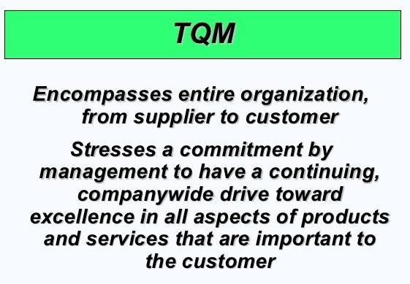

Slide 8
Total Quality Management
Managing the entire organization so that it excels in all dimensions of products and services that are important to the customer
Philosophical Elements
Customer Driven Quality
Leadership
Continuous Improvement
Employee's Participation
Quick Response
Quality Design and Prevention
Management by Fact
Work Partnership
Generic Tools
Tools of the Quality Control Department
SPC Tools
Process Flow Charts
Check Sheets
Pareto Analysis
Histogram
Cause and Effect (or Fishbone Diagram)
Run Charts
Scatter Diagram
Control Charts
SQC Methods
Sampling Plans
Process Capability
Taguchi Methods

Slide 9
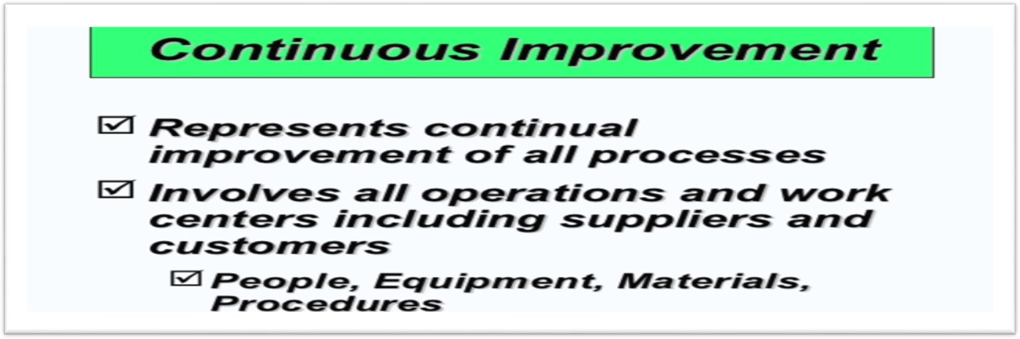
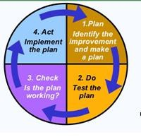

Slide 10
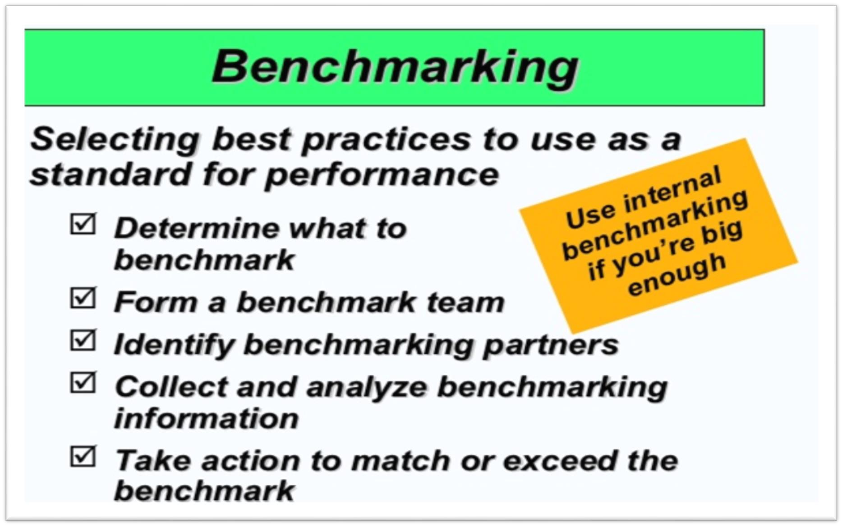

Slide 11

1. Prevention Costs / Pre-processing Costs
Cost of quality data acquisition and analysis for

prevention.
Cost of pilot production and scientific product
development.
Cost of engineering quality at design stage. Cost of quality planning and organization.
Product review analysis
Cost of process control and design of process control
systems.
Research and testing costs aimed at quality assurance






and quality enhancement
Cost of training for quality
Trouble shooting and failure analysis.
Cost of planned adjustments, repairs and
replacements on process machinery.
Administrative costs of systems and staff.

Slide 12
Appraisal Costs /On-processing Costs
Cost of inwards, in process and final inspection.
Cost of destructive test losses, if any.
Cost of preparation of reports and audits.
Cost of maintenance and collaboration of test
instrumentation and facilities.
Cost of administrative machinery and organization for inspection, testing and appraisal.
Products review cost.
Process control cost.
Quality engineering cost.
Field evaluation cost.

Slide 13
3. Failure Costs (Internal and External)
The first kind of failure costs–costs associated with the manufacture of products which fail on quality requirements are generally recognized as internal failure costs such as::
Cost of labour, materials, machine hours etc, loss in
scrapped items.
Costs of rework/reassembly and subsequent stages.
Cost of reprocessing and loss of worker morale.
Cost of failings to meet contracted schedules.
The second type of failure costs are those associated with the usage of products which fail on quality requirements, called external failure costs, such as:
Cost of loss of consumer goodwill.
Cost of loss of sales due to the publicity of failures.
Cost of attending to consumer complaints and repairs
(service costs).
Cost of replacements.

Slide 14
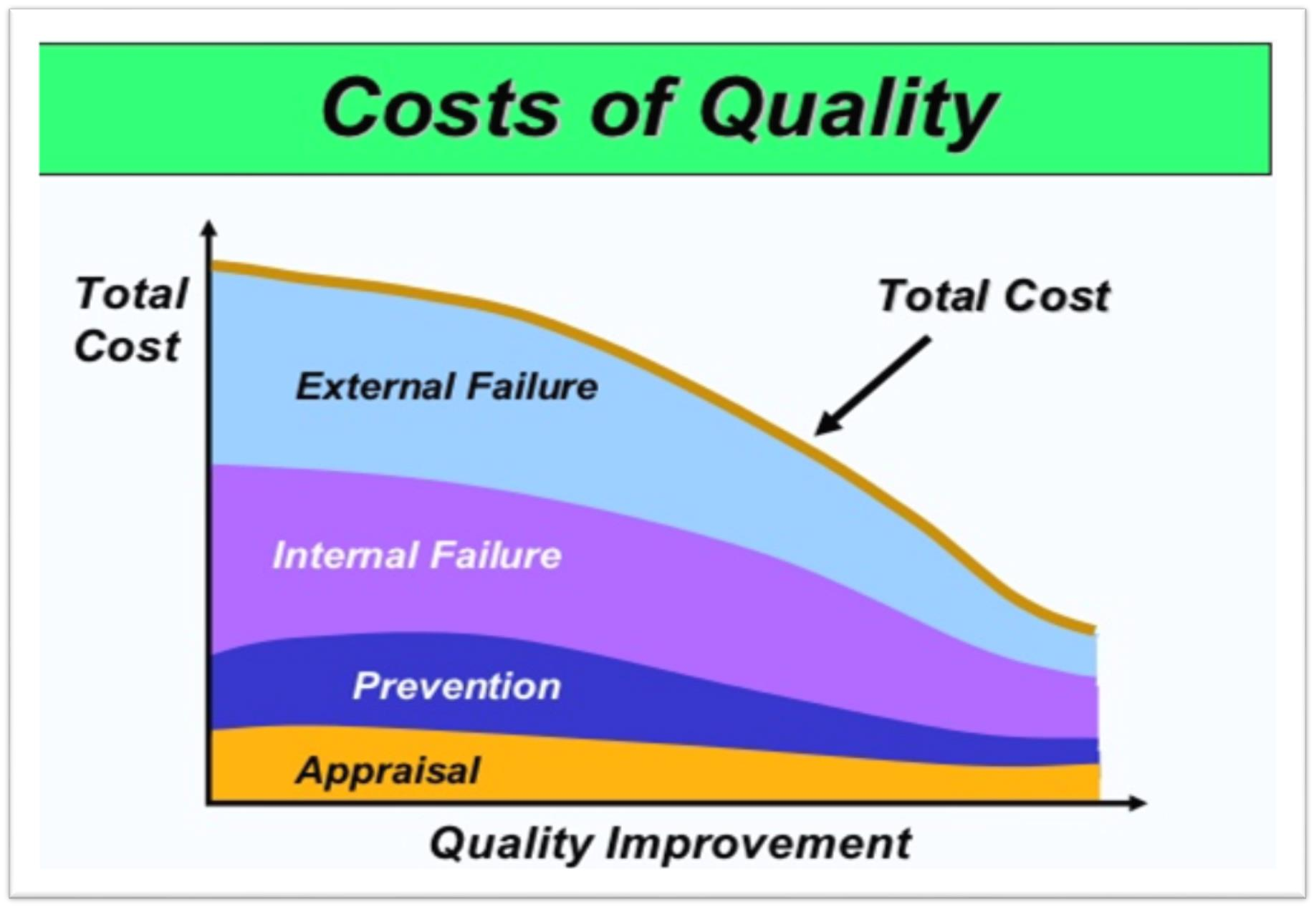

Slide 15
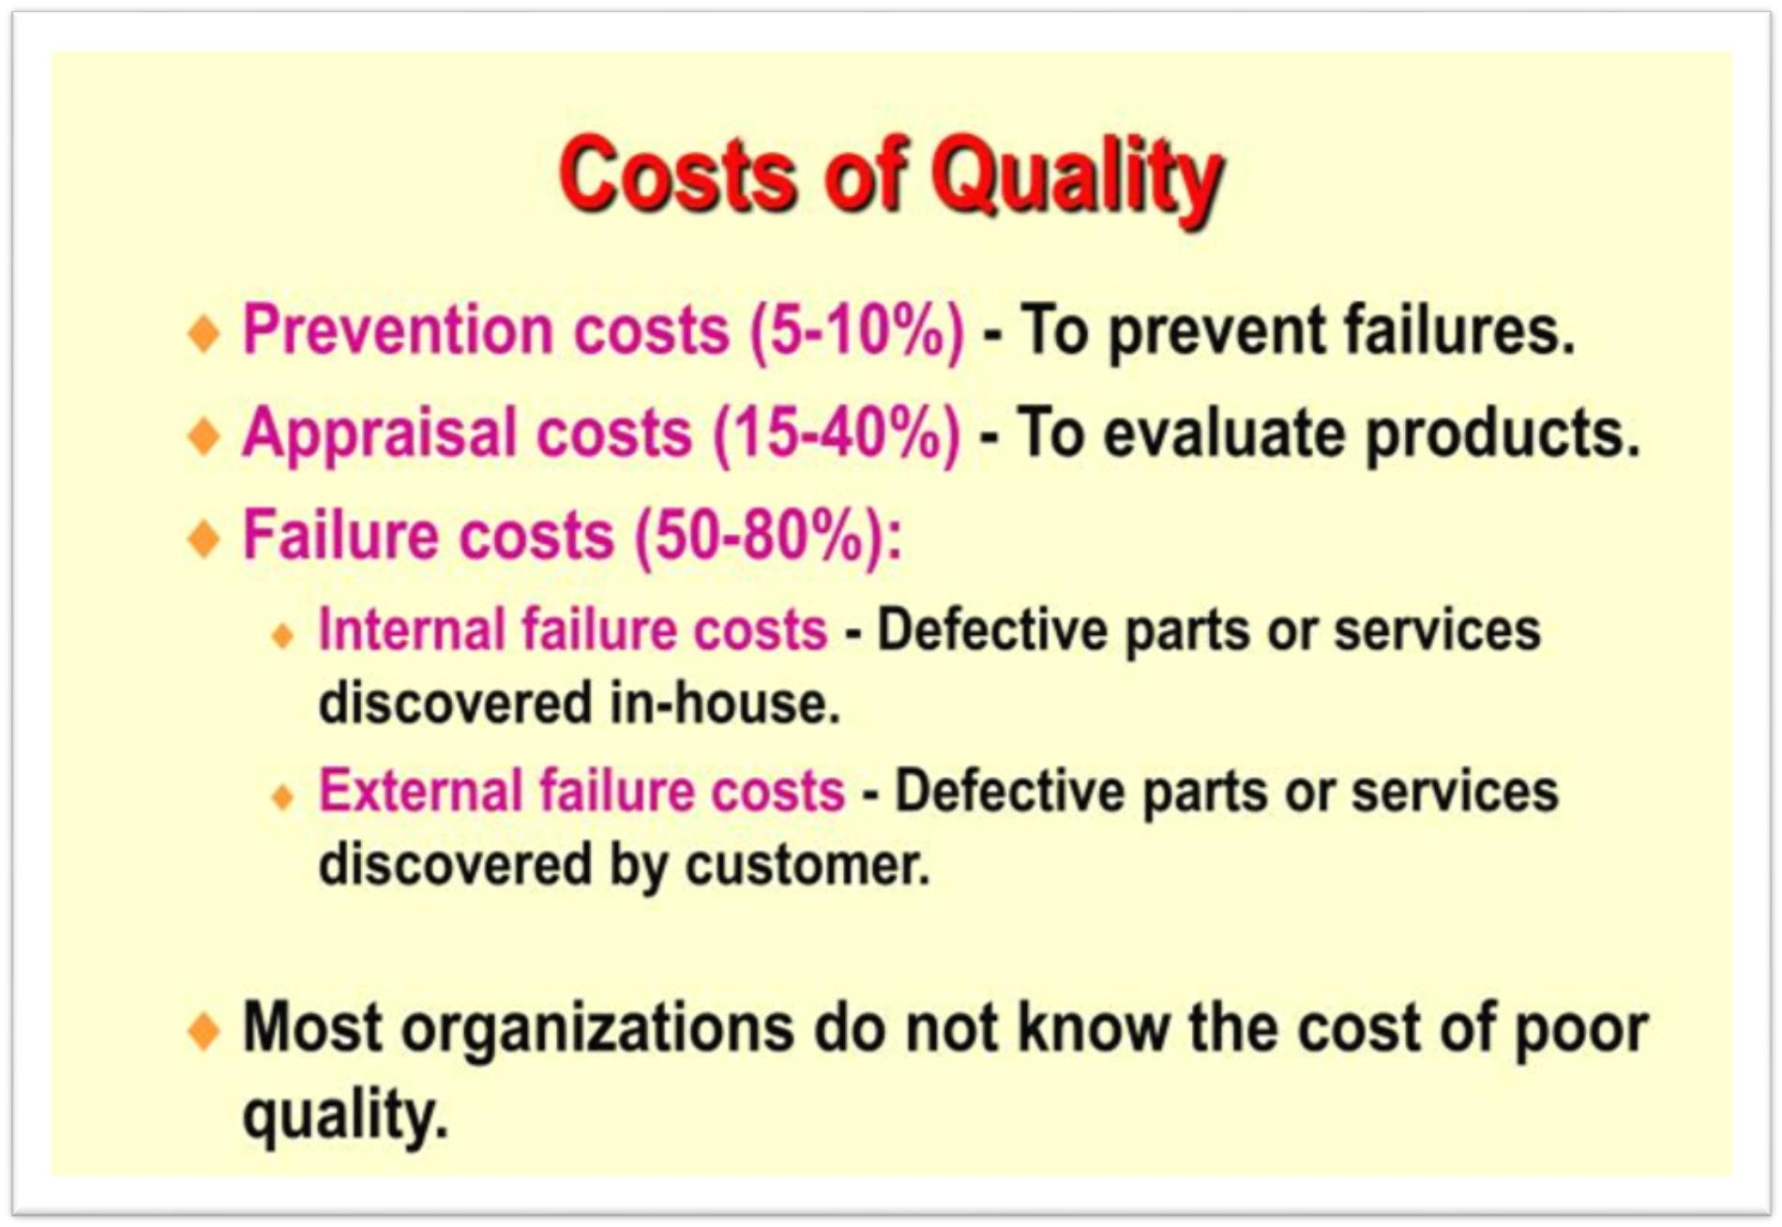

Slide 16
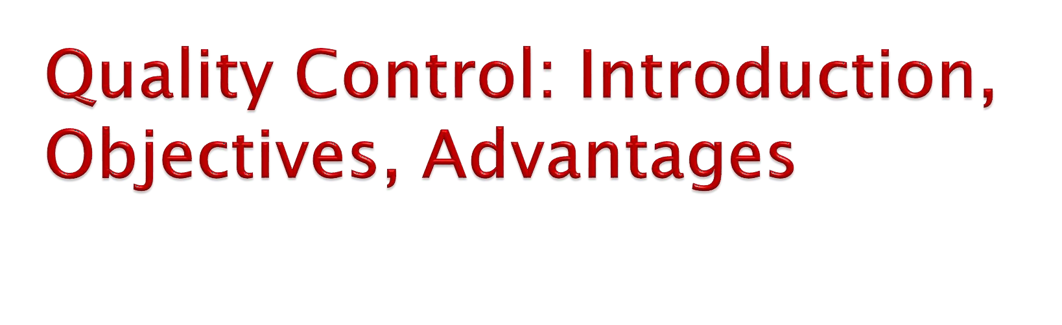
A quality control system is designed to ensure economical production of products of uniform quality which is acceptable to the customer.
The ultimate aim of quality control is to provide products which are dependable, satisfactory and economical.
The purpose of quality control is to assure that processes are performing in an acceptable manner.
Companies accomplish this by monitoring process
output using statistical techniques.
Quality control is a process that measures output relative to a standard and takes corrective action when output does not meet standards.
If the results are acceptable, no further action is required; unacceptable results call for corrective action.

Slide 17
Basically there are four factors that play important roles in controlling quality
of the products and services.
Quality of Materials
Materials are basic sources for the quality production. Material of good quality will result in smooth processing thereby reducing the waste and increasing the output. It will also give better finish to end products.
Quality of Manpower
Manpower is another factor that plays important role in controlling quality of the products and services. Trained and qualified personnel will give increased efficiency due to the better quality production through the application of skill and also reduce production cost and waste.
Quality of Machines
Today‘s quality of the products and services are based on another factor that is called quality of machinery. Better quality equipment will result in efficient work due to lack or scarcity of breakdowns and thus reduce the cost defectives.
Quality of Management
Effective and efficient management or managers are the very important factor in controlling products and services quality. A good management is imperative for increase in efficiency, harmony in relations, growth of business and markets

Slide 18
Objectives of Quality Control
Following are the important objectives of quality control:
To establish the desired quality standards which are
acceptable to the customers.
To discover variations in the raw materials and the manufacturing processes in order to ensure smooth and uninterrupted production.
To evaluate the methods and processes of production
and suggest further improvements in their functioning.
To study and determine the extent of quality deviation
in a product during the manufacturing process.
To analyze in detail the causes responsible for such
deviation.
To undertake such steps which are helpful in achieving
the desired quality of the product.

Slide 19
Advantages/Benefits of Quality Control
Uniform quality and reliability of product help in
increasing sales.
Reduced variability resulting in-higher quality and
reduced production bottle-necks.
Reduced cost of labour material as a result of reduced defectives.
Increased quality consciousness among employees.
Higher operating efficiency.
Better utilization of resources.
Reduced inspection and reduction inspection costs.
Reduced customer complaints.
Minimum scrap or rework due to reduced defectives.
Better customer satisfaction and employee satisfaction

Slide 20
Statistical Quality Control-SQC
Product Control
(By Acceptance Sampling Methods)
Process Control
(By Control Charts)
Variables |  |  | Attributes
Variables
Attributes
‾X Chart
R-Chart
Single Sampling Plan
Double Sampling Plan
Sequential Sampling Plan
P-Chart
np-Chart
C-Chart

Slide 21

A control chart is a time-ordered plot of sample statistic.
The basis for the control chart is the sampling distribution,
which essentially describes random variability.
There is, however, one minor difficulty relating to the use of a normal sampling distribution.
However, as a practical matter, we know that, say, 99.7 percent of the values will be within Standard deviations of the mean of the distribution.
Therefore, we could decide to set the limit, so to speak, at values that represent standard deviations from the mean, and conclude that any value that was farther away than these limits was a nonrandom variation.
In effect, these limits are control limits: the dividing lines between what will be designed as random deviations from the mean of the distribution and what will be designed as nonrandom deviations from the mean of the distribution.

Slide 22
Control Charts for Variables
Control charts for variable are used to monitor the mean and variability of the process distribution.
The variables of interest here are those that have continuous dimensions.
They have an infinite number of possibilities.
Examples are weight, speed, length, or strength. Control charts for the mean, or x-bar, and the range, R, are used to monitor processes that have continuous dimensions.
An example of mean chart is for controlling variables shown in figure below:

Slide 23
Process Out of Control
Process in Control
×
Upper Control Limit (UCL)
×
×
+3σ
(3 Standard Deviation)
Quality Characteristics
×
Central Limit (CL)
×
–3σ
(3 Standard Deviation)
Lower Control Limit (LCL)
×
Process Out of Control
Sample Number

Slide 24
Range Chart
=
UCL = X + A₂‾R
=
CL = X
Mean Chart (‾x) =
=
LCL = X – A₂ ‾R
UCL =D₄‾R
CL =‾R
Range chart (R) =
LCL =D₃‾R

Slide 25
Factors for Computing Central Lines and 3σ Control Limits for , mean , S, and R, Charts
Number of Observations in Sample π n | Chart for Averages |  |  | Chart for Ranges
 | Factors for Control Limits |  |  | Factors for Control Limits
 | A | A₁ | A₂ | D₁ | D₂ | D₃ | D₄
2 | 2.121 | 3.760 | 1.880 | 0 | 3.686 | 0 | 3.267
3 | 1.732 | 2.394 | 1.023 | 0 | 4.358 | 0 | 2.576
4 | 1.500 | 1.880 | 0.729 | 0 | 4.698 | 0 | 2.282
5 | 1.342 | 1.596 | 0.577 | 0 | 4.918 | 0 | 2.115
6 | 1.225 | 1.410 | 0.483 | 0 | 5.078 | 0 | 2.004
7 | 1.134 | 1.277 | 0.419 | 0.205 | 5.203 | 0.076 | 1.924
8 | 1.061 | 1.175 | 0.373 | 0.387 | 5.307 | 0.136 | 1.864
9 | 1.000 | 1.094 | 0.337 | 0.546 | 5.394 | 0.184 | 1.816
10 | 0.949 | 1.028 | 0.308 | 0.687 | 5.469 ^{ww} | w.₀st.u₂d₂y₃note | sn₁e_{.7}p₇al₇.co
m

Slide 26
Example of Mean Chart and Range Chart: The following data give the weight of an automobile parts five samples of four each items were taken on a random sample basis the Mean and Range control charts and find out whether processes are under the control or not.
Sample | Sample observation |  |  |  | ‾x | R
1 | 10 | 12 | 10 | 12 | 11 | 2
2 | 10 | 12 | 13 | 13 | 12 | 3
3 | 10 | 10 | 9 | 11 | 10 | 2
4 | 11 | 10 | 9 | 14 | 11 | 5
5 | 12 | 12 | 12 | 12 | 12 | 0
Total |  |  |  |  | Σ‾x = 56 | ΣR = 12
Solution:
Now,
=
Σ‾x 56
Grand mean (X ) = _{n} = ₅ = 11.2
Average Range (R) = _{n} = ₅ = 2.4
ΣR 12

Slide 27
Value for A2, when sample size (n) = 4 is 0.729 (from the table of "Factors for computing central lines and 3σ central limits for‾X, S1 and R, charts") values for D3 and D4, when sample size (n) = 4 are 0 and 2.282 respectively (From the same table).
Now,
Central Limit (CL) = X = 11.2
Upper control Limit (UCL) = X + A2 ‾R
= 11.2 + 0.729 × 2.4 = 12.9496
=
=
=
Lower control Limit (LCL) = X – A2‾R
= 11.2 – 0.719 × 2.4 = 9.4504

Slide 28
14
13
12
11
10
9
8
Sample mean
UCL = 12.9496
×
×
×
×
CL = 11.2
×
LCL = 9.4504
1 2 3 4
Sample Number
5
6
Conclusion: The process is in control as all sample means are within control
limits.

Slide 29
6
5
4
3
2
1
0
×
UCL = 5.4968
Range (R)
×
×
×
CL = 2.4
×
₆ LCL = 0
1 2 3 4 5
Sample Size (Number)
Central Limit (CL) = ‾R = 2.4
Upper control Limit (UCL) = D4‾R = 2.282 × 2.4 = 5.4768 Lower control Limit (LCL) = D3‾R = 0 × 2.4 = 0
Conclusion: The process is in control as all sample ranges are within control limits

Slide 30
Control Charts for Attributes
Control charts for mean and range do not apply when we are sampling attributes, which are typically classified as defective or non-defective.
Measuring defectives involves counting them (for example, number of bad light bulbs in a given lot, or number of letters or data entry records typed with errors), whereas variables are usually measured for length or weight.
There are three kinds of attribute control charts:
those that measure the percent defective in a sample-
called p-charts
those that measure the number of percent defective in
a sample-called np-chart and
(3) those that count the number of defects-called c-
charts.

Slide 31
a. P–Chart (Percent Defective Chart or Fraction Defective Chart)
Two charts commonly used for performance measures based on
attributes.
The performance characteristics is counted rather than measured, and the entire service or item can be declared good or defective.
For example, in the banking industry, the attributes counted might be the number of no endorsed deposits or the number of incorrect financial statements sent to customers.
Equation/Formula:
(Note: if defects/errors are given in decimal basis)
_{−p =} ∑D
CL=
N × n
−_{p} −_{q} N
−_{p q}−
N
UCL⁻
−
p
= p + 3 ×
LCL⁻
−
p
= p – 3 ×

Slide 32
Where, D = Defects/errors
N = Units/Items/deposits/sample size
n = sample number/observation
Example : Electro lamp Corporation is the manufacturer of emergency lights. The Quality Control Manager has collected the following data from a day's production to check whether the light to light or not:
S.N. | No. of lamps tested | No. of lamps not lighting | S.N. | No. of lamps tested | No. of lamps not lighting
1 2 3 4 5 | 200 200 200 200 200 | 20 2 18 14 16 | 6 7 8 9 10 | 200 200 200 200 200 | 12 10 8 14 16
Draw a p-chart for the quality control for 99.73% confidence interval (Z =
3). What is your comment about the process?
Solution
Number of units (N) = 200
Sample (n) = 10

Slide 33
⁻p = ^{∑D} = ¹³⁰ = 0.065
N × n 200 × 10
⁻q = 1 – 0.065 = 0.935
CL⁻p = 0.065
_{p}− _{q}−
_{N} = 0.065 + 3 ×
0.065 × 0.935
200
−
UCL⁻p = p + 3 ×
= 0.065 + 0.0523 = 0.1173
_{p}− −_{q}
_{N} = 0.065 – 3 ×
0.065 × 0.935
200
LCL⁻p
−
= p – 3 ×
= 0.065 – 0.0523 = 0.0127

Slide 34
Calculations of percent defective values
Sample s | No. of lamps tested (N) | No. of lamps not lighting (d) | 𝒅 p = 𝑵
1 2 3 4 5 6 7 8 9 10 | 200 200 200 200 200 200 200 200 200 200 | 20 2 18 14 16 12 10 8 14 16 | 0.1 0.01 0.09 0.07 0.08 0.06 0.05 0.04 0.07 0.08

Slide 35
P-chart
0.12
0.11
0.10
0.09
0.08
0.07
0.06
0.05
0.04
0.03
0.02
0.01
0
UCL = 0.1173
Fraction Defectives
CL = 0.065
LCL = 0.0127
1
2
3 4 5 6
Samples
7
8
9 10
Decision: The process is not under the control because one of the observations (i.e. sample 2) equal to 0.01 is under the LCL level. To make it under control 2nd observation should be removed from the sample.

Slide 36
b. Np-chart (Number of Percent Defective Chart)
Np-chart is modified form of p-chart in which number of defectives are used instead of fraction defectives.
In other words, control charts for number of defectives (Np-chart) shows the actual number of defectives found in each sample if the number of items inspected each time is same, the plotting of the actual number of defective may be more convenient and meaningful than the fraction defective.
Np-chart and control limits can be calculated as follows:
Equation/Formula:
(Note: if defects/errors are given is number basis)
CL = Np⁻
_{−p =} ∑D
N × n

Slide 37
UCL_{NP} = N⁻p + 3 N⁻p⁻q LCL_{NP} = N⁻p – 3 N⁻pq⁻
Example : A visual inspection for scratches (each unit is judged good or bad) on a decorative paint trim produced the following data for the last week. For each sample, 30 were inspected. Construct suitable chart.
Samples | 1 | 2 | 3 | 4 | 5 | 6 | 7 | 8 | 9 | 10
Defectives | 5 | 4 | 4 | 5 | 7 | 4 | 5 | 6 | 4 | 5
Solution
Given,
Number of units (N) = 30 units
Sample (n) = 10

Slide 38
Now,
_{−p =} Total defects ₌ ∑D ₌ 49 _{= 0.16} Total no. of defective items N × n 30 × 10
⁻q = 1 – p⁻ = 1 – 0.16 = 0.84
CL = NP = 30 × 0.16 = 4.8
UCLNP = N⁻p + 3 Np⁻q⁻ = 4.8 + 3 4.8 × 0.84 = 4.8 + 6.02 = 10.82
LCLNP = N⁻p – 3 N⁻p⁻q = 4.8 – 6.02 = –1.22 ≈ 0

Slide 39
Np-chart
11
UCL = 10.82
10
9
8
7
6
Defective s
5
CL = 4.8
4
3
2
1
0
3
4 5 6
Samples
LCL = 0
1
2
7
8
9
10
Conclusion: The process is under control because all the defective
values lie between upper control limit and lower control limit.

Slide 40
c. C-chart (Combined or Mixed Chart)
Sometimes services or products have more than one defect.
For example, a roll of carpeting may have several defects, such as tufted or discolored fibers or stains from the production process.
When management is interested in reducing the number of defects per unit or service encounter, another type of control chart, the c-chart, is useful.
Equation/Formula
(Note: if ‗N‘ is not given)
_{−c =} ∑D
CL=
n
− −
UCL = C + 3 C
LCL = ⁻ – 3 ⁻
C C

Slide 41
Example : Construct a control chart with three-sigma limits for the number of defects per spool of cable, given the following data. Is the process in control?
Observation | 1 | 2 | 3 | 4 | 5 | 6 | 7 | 8 | 9 | 10 | 11 | 12 | 13 | 14
No. of Defects | 2 | 3 | 1 | 0 | 1 | 3 | 2 | 0 | 2 | 1 | 3 | 1 | 2 | 0
Solution
Samples (n) = 14
∑D = 21
Then,
−
∑D 21
c = _{n} = ₁₄ = 1.5
UCL = ⁻ + 3 ⁻
C C
= 1.5 + 3 1.5 = 5.17
LCL = ⁻ – 3 ⁻
C C
= 1.5 – 3 1.5 = –2.17 ≈ 0

Slide 42
C-chart
6
5
4
3
2
1
No. of Defects
UCL = 5.17
CL = 1.5
1 2 3 4 5 6 7 8 9 1 1 12 13
Observation ⁰ ¹
LCL = 0
14
Conclusion: The process is under the control because all the defects are within the
upper control limits and lower control limits.

Slide 43
Today‘s very popular philosophy of ―Just In Time (JIT)‖ was originally, but in incomplete, form developed by Henry Ford (USA) before 1900. But the concept was unable to use in American manufacturing companies.
For the first time, in a complete form, it was developed and successfully used by the Taii-chi Ohno (Japan), a former shop manager and vice president of Toyota Motor Company in early of 1970s for the purposes of eliminating seven different wastes.
Later on, the same concepts but in modified form, it was also used
by some of the German manufacturing companies successfully.
Because of this, both countries are known as quality manufacturing countries all over the world.
JIT required only necessary units to be produced and provided at
necessary times.
Making of one unit extra is as bad as being one unit short. Similarly, completing production one day early is as bad as finishing one day late.
Therefore, items are supplied only when needed, or "just in time".

Slide 44
1. WHAT IS JIT? (FEATURES) | 2. WHAT JIT DOES? (FUNCTIONS)
Intermittent production system and Pull method of material flow Close supplier ties (sound suppliers system) Flexible work force (Factory networking) Automated production system Preventive maintenance Zero inventories/stocks Zero lead time Outsourcing and contracting provisions etc. | Elimination of wastes/Attacks wastes Reduction in size of stocks or inventory Process time, space requirement and set up time are reduced considerably Improve customer-service and commitments, bringing competitive advantage Improve productivity Reduction in unnecessary costs Appreciates fair competition Continuous Improvement Strives for 100% quality production etc.
3. HOW JIT DOES? (ELEMENTS) | 4. WHAT JIT ASSUMES? (BASIS)
Employees participation (Quality circle) Kanban system of production Developing Kaizen system Flexible manufacturing system Total quality management (control) Business process re-engineering (BPR) Focus on the factory network Quality at source etc. | Stable environment Predictable customer demand Zero inventory and no lead time Quick response, quality production Good relation (customers and suppliers), No wastes etc.

Slide 45
Just in time manufacturing is a philosophy rather than a technique.
By eliminating all waste and seeking continuous improvement, it aims at creating a manufacturing system that is responsive to the market needs.
JIT is a manufacturing system whose goal is to optimize processes and procedures by continuously pursuing waste reduction.
JIT provides for the cost efficient production in an organization and delivery of only necessary parts in the right quantity at the right time and place while using the minimum if facilities.
JIT enables one to conceive, design, implement and operate a manufacturing and supporting systems, as an integrated whole based on the principles of continuous improvement and elimination of all kinds of waste.

Slide 46

To facilitate the implementation of JIT, Hall suggests the
following approach:
Obtain commitment from top management.
Prepare an implementation plan.
Gain the co-operation of the work force.
Create a strong leadership on the shop floor.
Guarantee stable employment, engage training and
encourage participation and teamwork.
Level the production and smoothen the flow.
Reduce set up times of machines/equipments.
Provide spare capacities in all areas.
Extend JIT to suppliers.
Remove the bottlenecks/problems and stabilize delivery schedules.

Slide 47
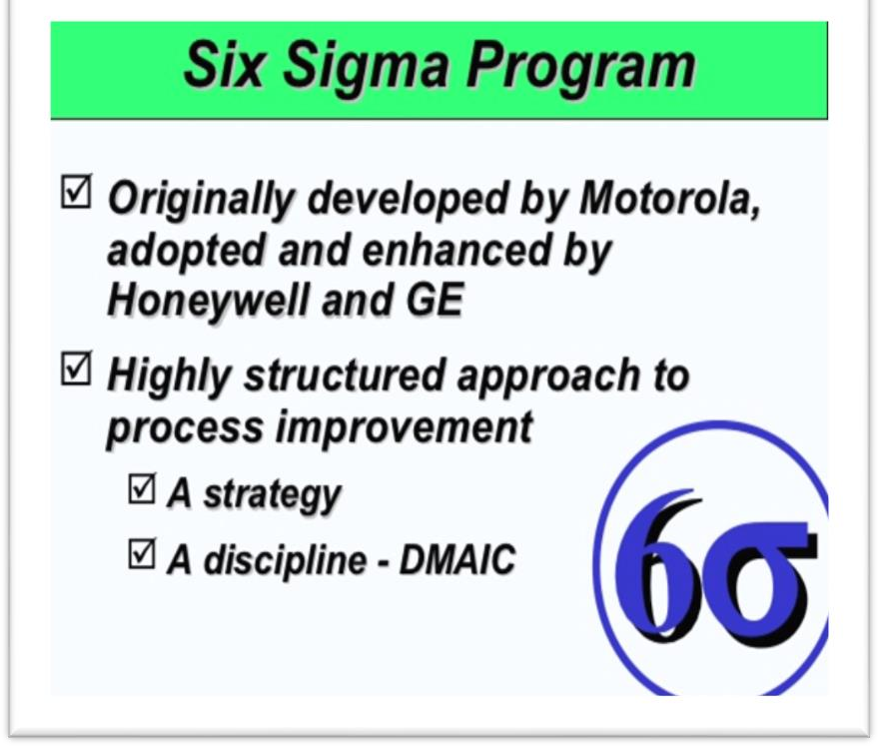

The six sigma concept was developed by Bill Smith, a senior engineer at Motorola, in 1986 as a way to standardize the way defects were tallied.
Sigma is the Greek symbol used in statistics to refer to standard deviation which is a measure of variation.
Adding ―six‖ to ―sigma‖ combines a measure of process performance (sigma) with the goal of nearly perfect quality (six).
More specifically, to some the term Six Sigma literally translate into making no more than 3.4 mistakes (defects) per 1 million opportunities to make a mistake (defects).
Basically, Six Sigma is a project-oriented methodology (or system) that provides
businesses with the tools and expertise to improve their processes.
This increase in performance through a decrease in process variation leads to defect reduction (to near zero) and an increase in product and service quality and increased profits.
The basic components of six sigma are shown in figure below:

Slide 48
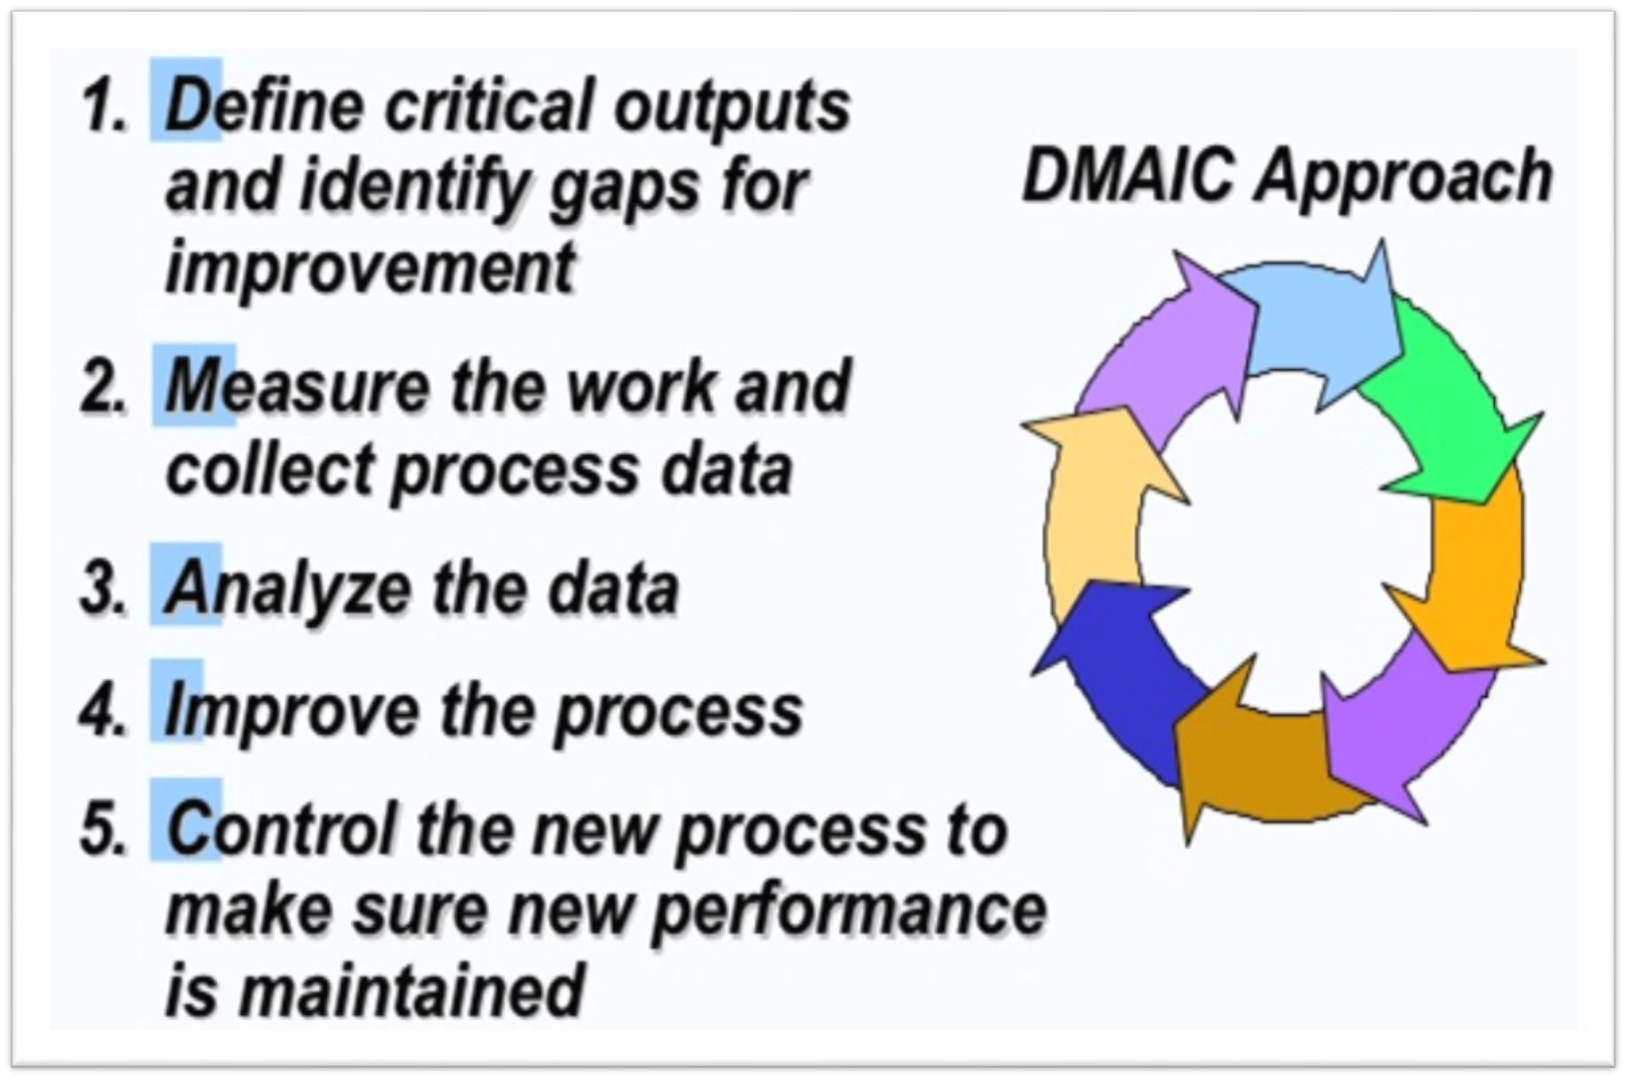

Slide 49







Goals for process improvement
The customer
Project scope
The problem/opportunity
Define
Identify appropriate performance measure
Collect data
Evaluate current process performance
Measure
Develop and test theories related to root causes of problems
Identify cause and effect relationships
Analyze
Improve
Develop and evaluate solutions to reduce gap between desired process performance and current performance
Control
Monitor process to sustain improved performance
Ensure that problems do not resurface

Slide 50
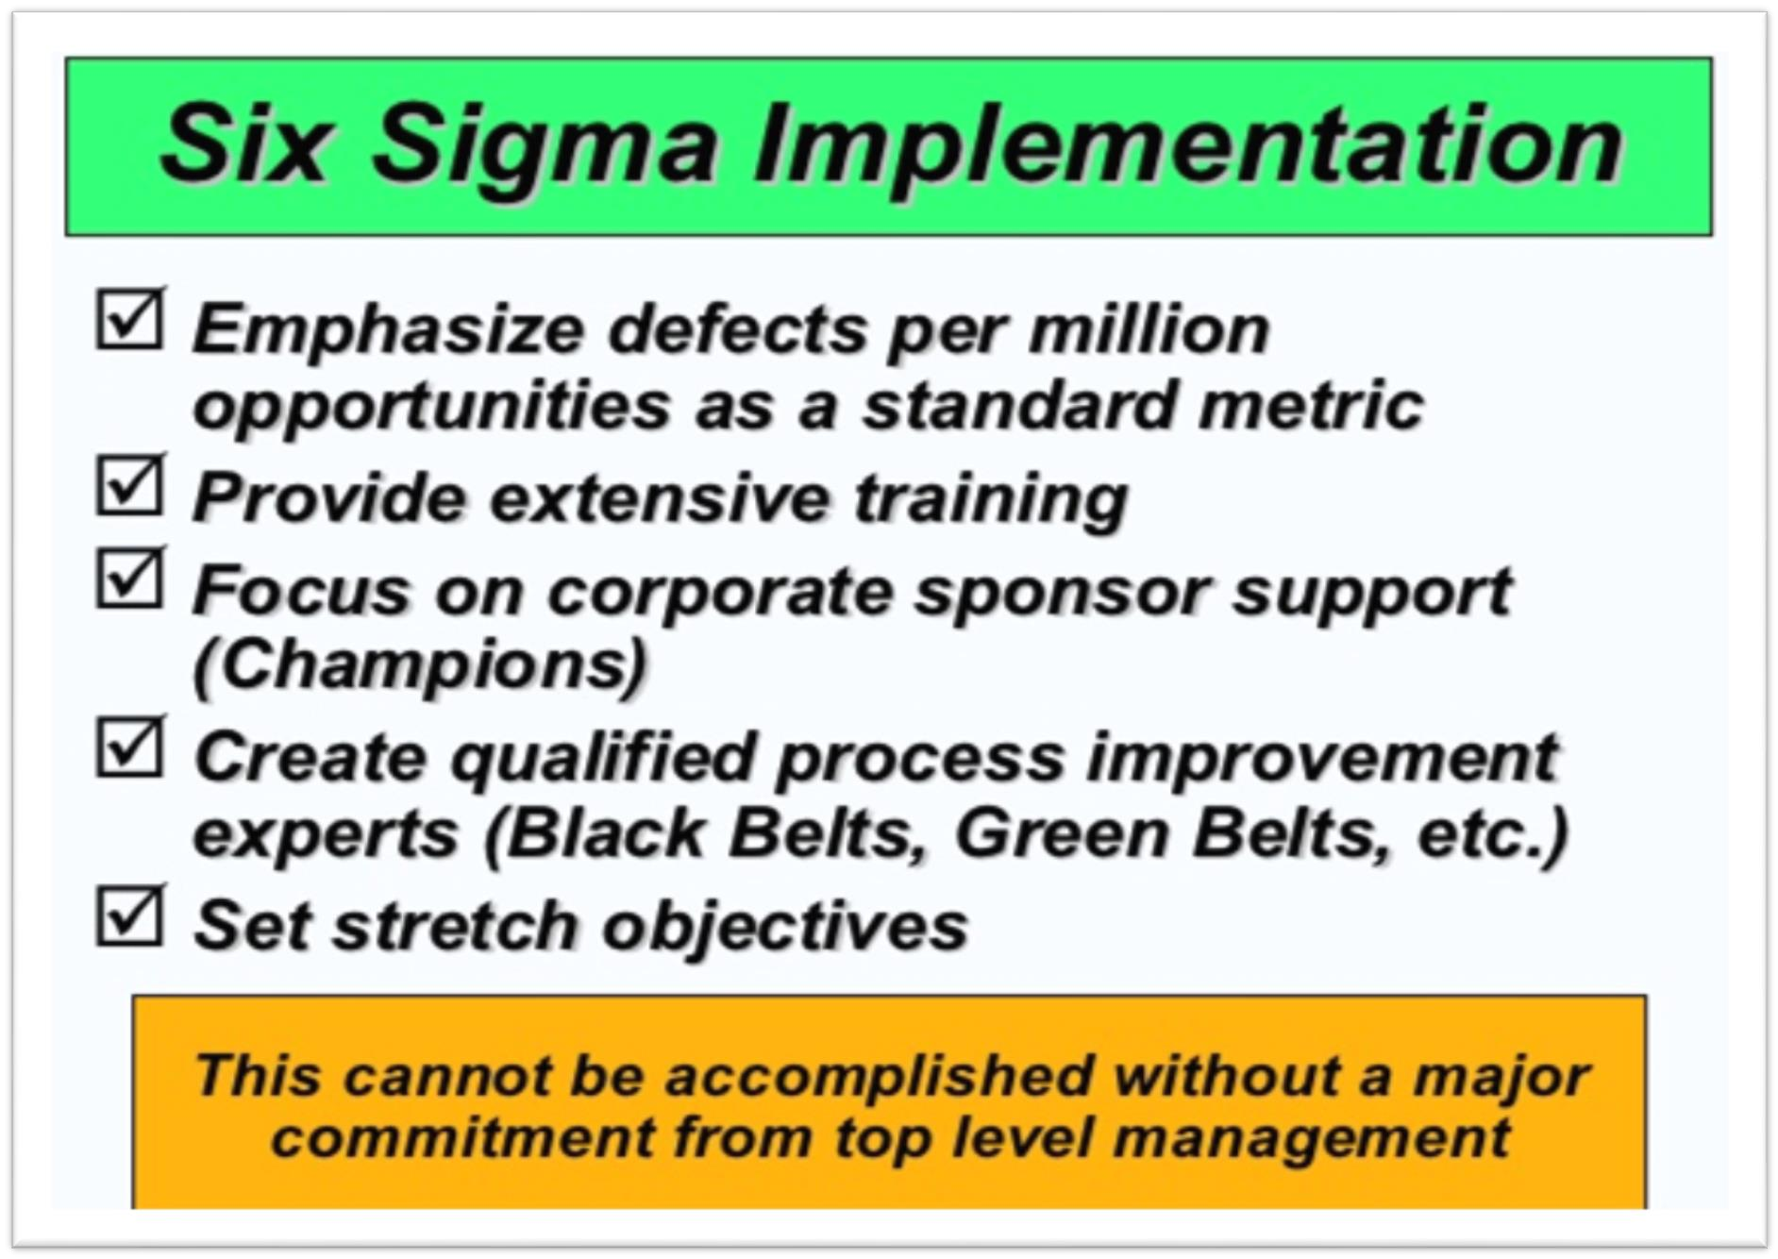

Slide 51

ISO stands for "International Organization for Standardization."
Head office at Geneva, Switzerland.
As a voluntarily organization, it was established in 1947.
Rules, regulations, policies, and strategies of ISO 9000 series were
developed in 1982.
Rules, regulations, policies, and strategies of ISO 9000 series were formally released in 1987 and revised twice in 1994 and 2000 – 2001.
ISO 9000 series includes 9000, 9001, 9002, 9003 and 9004.
It follows decentralized system for quality certification.
224 technical committees and more than 3000 sub-technical committees were formed and working for quality certification all over the world.
More than 140 countries and more than 500 international
organizations are accepting the norms or standards of ISO 9000 series.
Till Ganga Eye Hospital was the first Nepalese organization that awarded by ISO 9000 series.
More than 65 Nepalese organizations are awarded partly or fully by ISO
9000 series.

Slide 52
ISO 9000 Series | Standards
ISO 9000 | Quality Management and Quality Assurance Standards, Guidelines for selection and Use
ISO 9001 | Quality Systems–Model for Quality Assurance in Design, Development, Production, Installation and Servicing
ISO 9002 | Quality System–Model for Quality Assurance in Production, Installation and Servicing
ISO 9003 | Quality System–Model for Quality Assurance in Final Inspection and Test

Slide 53
A. Tools for generating ideas
Check sheet
Scatter diagram
Cause and effect diagram
B. Tools to organize data
Pareto charts
Process charts (Flow diagrams)
C. Tools for identifying problems
Histograms
Statistical process control chart

Slide 54
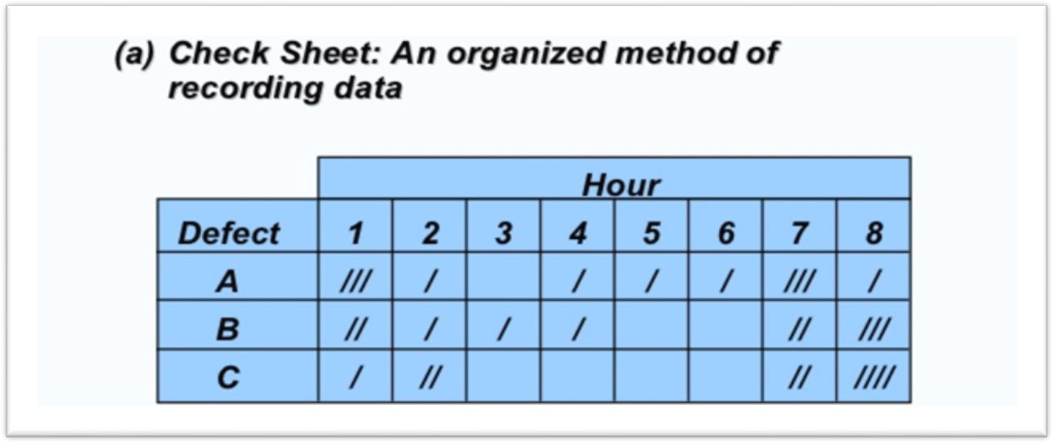
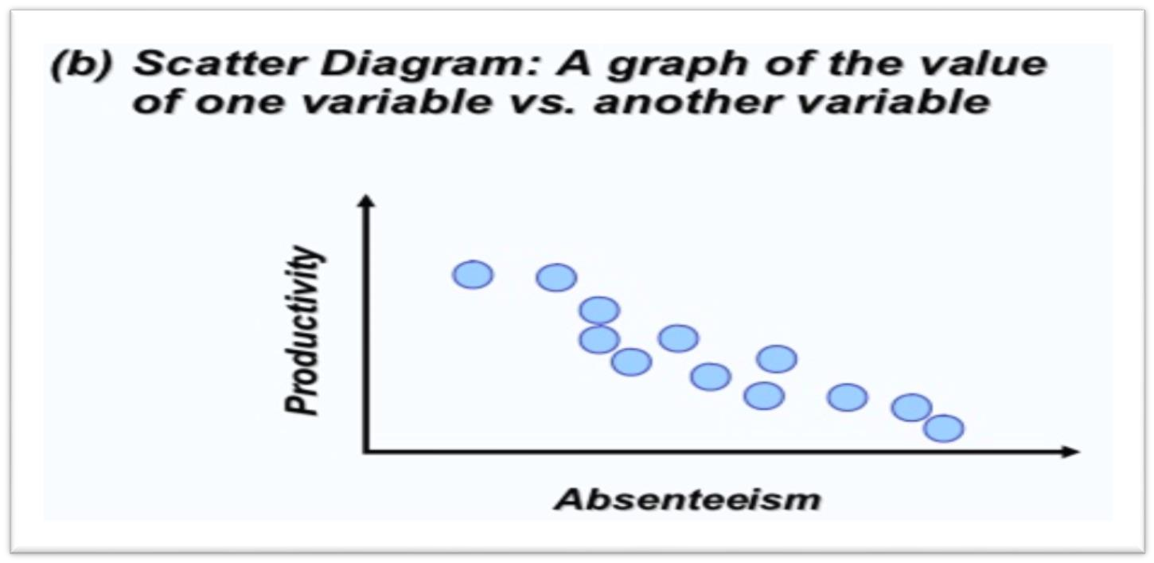

Slide 55
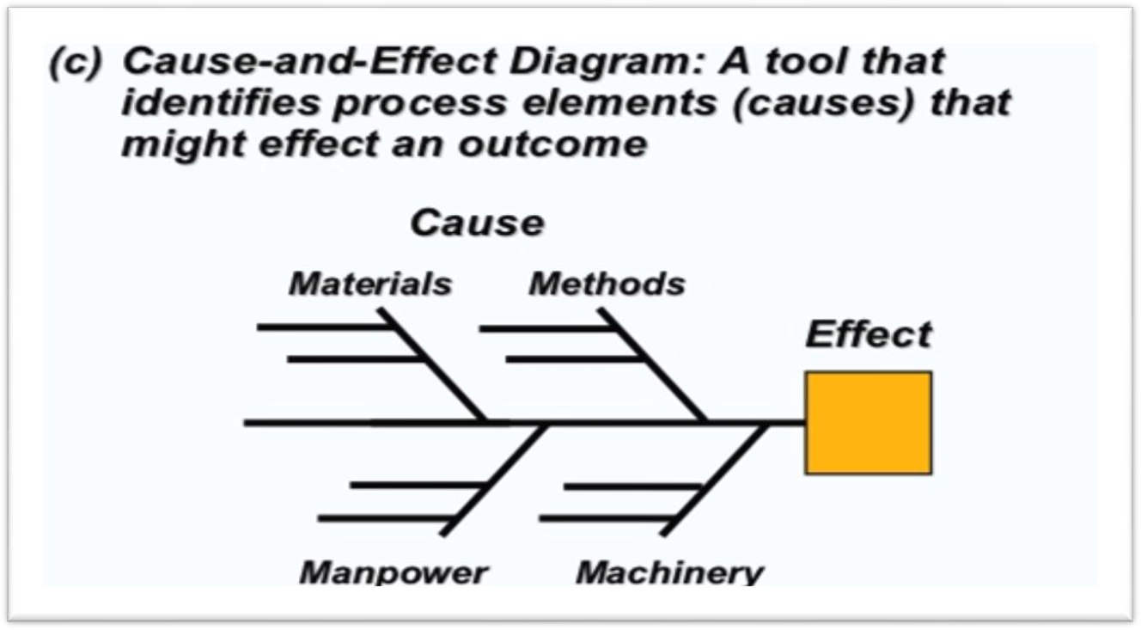

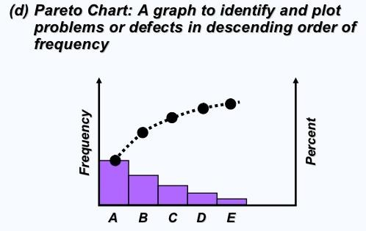

Slide 56
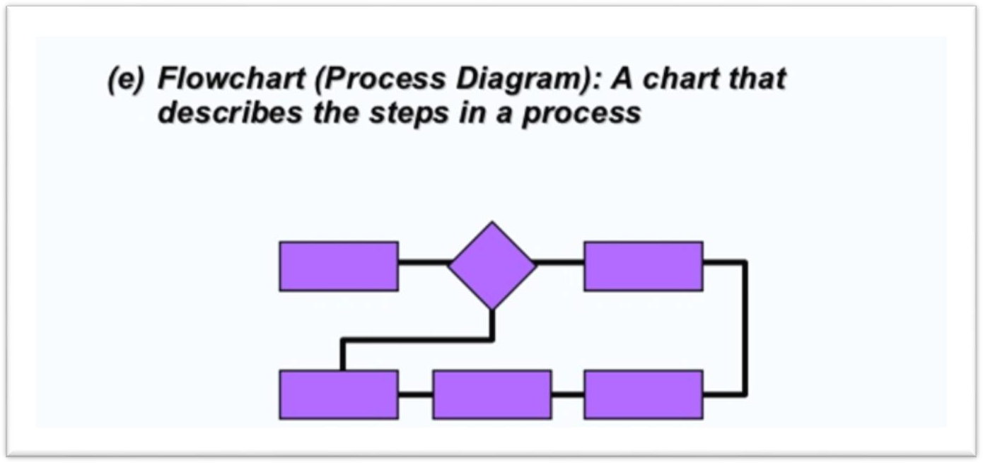
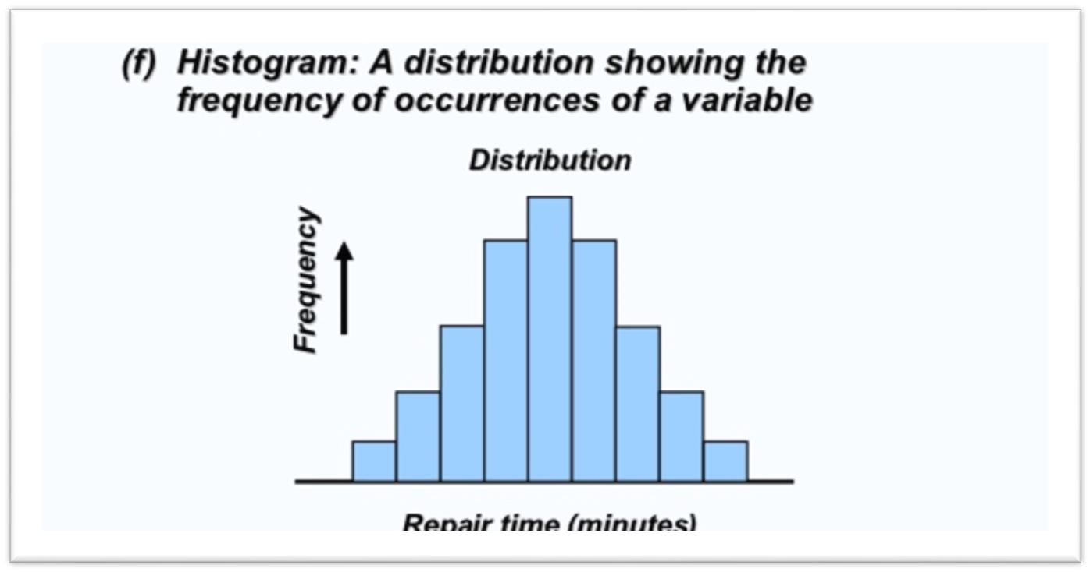

Slide 57
